Slide 1
Figure SPM.1
Climate change is unprecedented

Slide 2
Figure SPM.1
Human influence has warmed the climate at a rate that is unprecedented in at least the last 2000 years

Slide 3
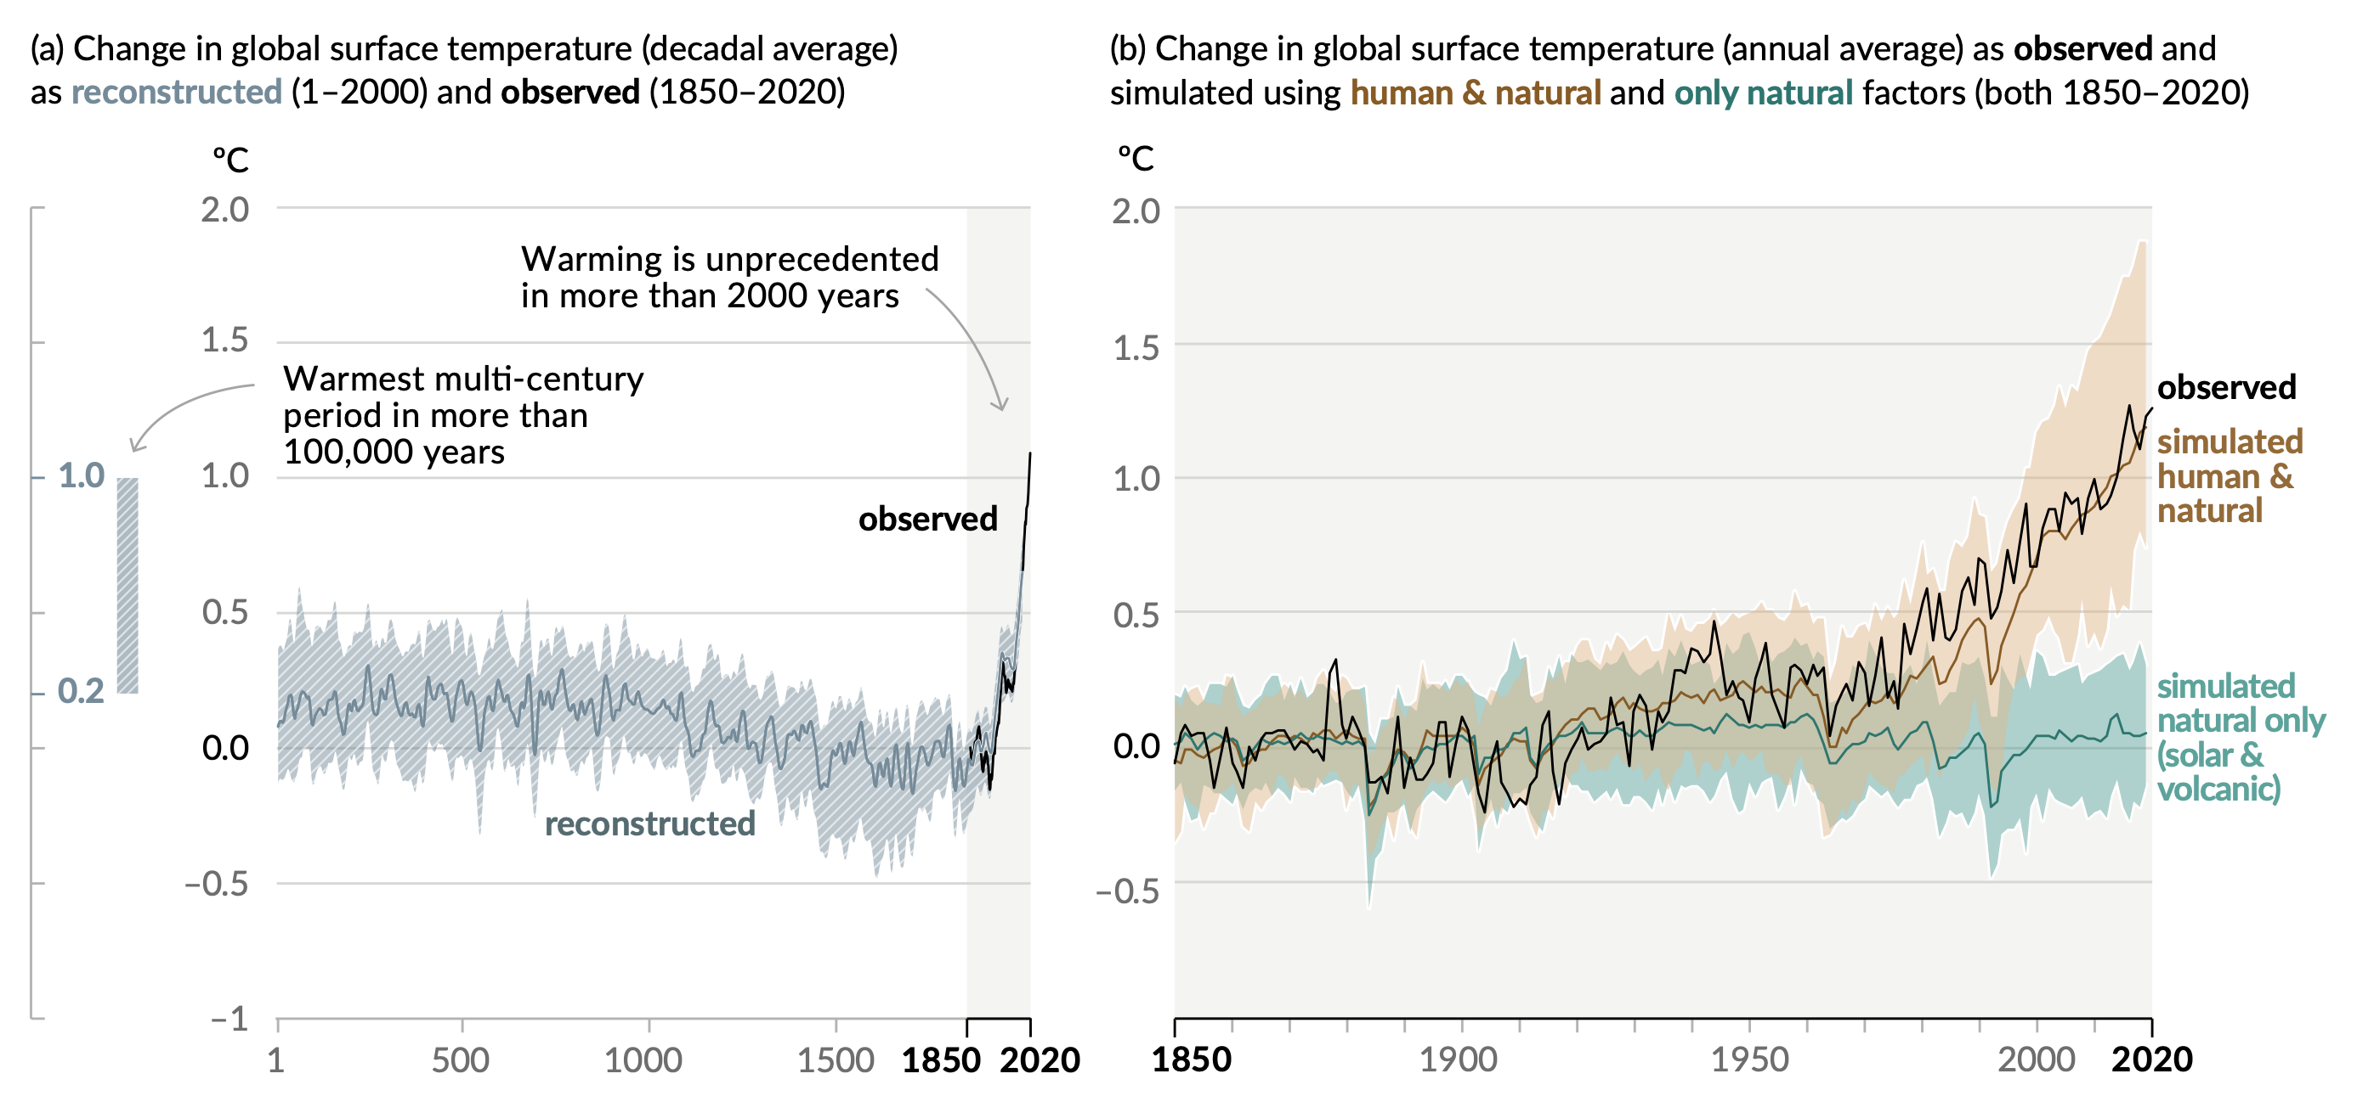
Figure SPM.1
Changes in global surface temperature relative to 1850-1900
Human influence has warmed the climate at a rate that is unprecedented in at least the last 2000 years
Notes:
The intent of this figure is to show that human influence has warmed the climate at a rate that is unprecedented in at least the last 2000 years.
This figure has two important messages:
Climate is warming at a rate that is very unusual – this can be seen in the left panel.
The climate is warming as a consequence of human activities – this can be seen in the right panel.
-----------------------------------Caption-----------------------
Figure SPM.1 | History of global temperature change and causes of recent warming
Panel (a) Changes in global surface temperature reconstructed from paleoclimate archives (solid grey line, years 1–2000) and from direct observations (solid black line, 1850–2020), both relative to 1850–1900 and decadally averaged. The vertical bar on the left shows the estimated temperature (very likely range) during the warmest multi-century period in at least the last 100,000 years, which occurred around 6500 years ago during the current interglacial period (Holocene). The Last Interglacial, around 125,000 years ago, is the next most recent candidate for a period of higher temperature. These past warm periods were caused by slow (multi-millennial) orbital variations. The grey shading with white diagonal lines shows the very likely ranges for the temperature reconstructions.
Panel (b) Changes in global surface temperature over the past 170 years (black line) relative to 1850–1900 and annually averaged, compared to Coupled Model Intercomparison Project Phase 6 (CMIP6) climate model simulations (see Box SPM.1) of the temperature response to both human and natural drivers (brown) and to only natural drivers (solar and volcanic activity, green). Solid coloured lines show the multi-model average, and coloured shades show the very likely range of simulations. (See Figure SPM.2 for the assessed contributions to warming). {2.3.1; Cross-Chapter Box 2.3; 3.3; TS.2.2; Cross-Section Box TS.1, Figure 1a}

Slide 4
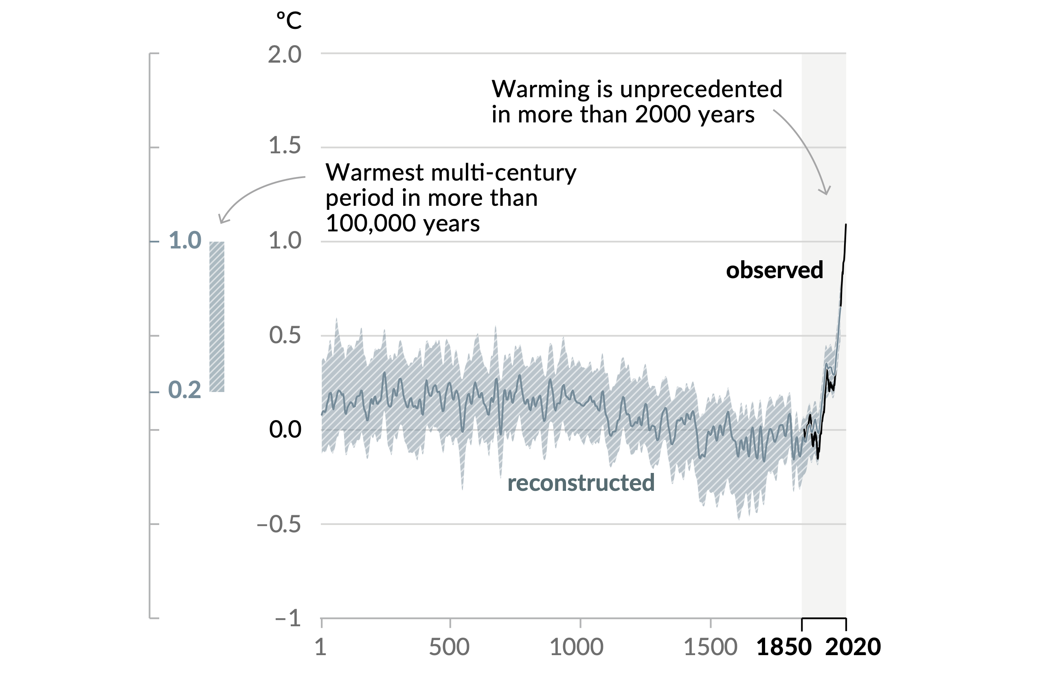
Figure SPM.1
Panel a
Change in global surface temperature (decadal average) as reconstructed (1-2000) and observed (1850-2020)
The Earth's surface is warming at a rate that is very unusual
Unprecedented in at least 2000 years
Notes:
This figure shows global surface temperature reconstructed from paleoclimate archives (grey line) over the past 2000 years, and from direct observations (in black line) since 1950 to present.
The observed warming rate since the 1970s is unprecedented in at least 2000 years.

Slide 5
Figure SPM.1
Panel a
Change in global surface temperature (decadal average) as reconstructed (1-2000) and observed (1850-2020)
The Earth's surface is warming at a rate that is very unusual
Unprecedented in at least 2000 years
Warmest since the last 100 thousand years
Notes:
The vertical bar on the left hand side shows the estimated temperature during the warmest multi-century period in at least the last 100,000 years, which occurred around 6500 years ago during the current interglacial period (the Holocene period).
The global surface temperature we have now is the warmest in about the last 100 thousand years.
This shows that warming of the last decade is outside of the range of the current interglacial period (since more than 100 000 years).

Slide 6
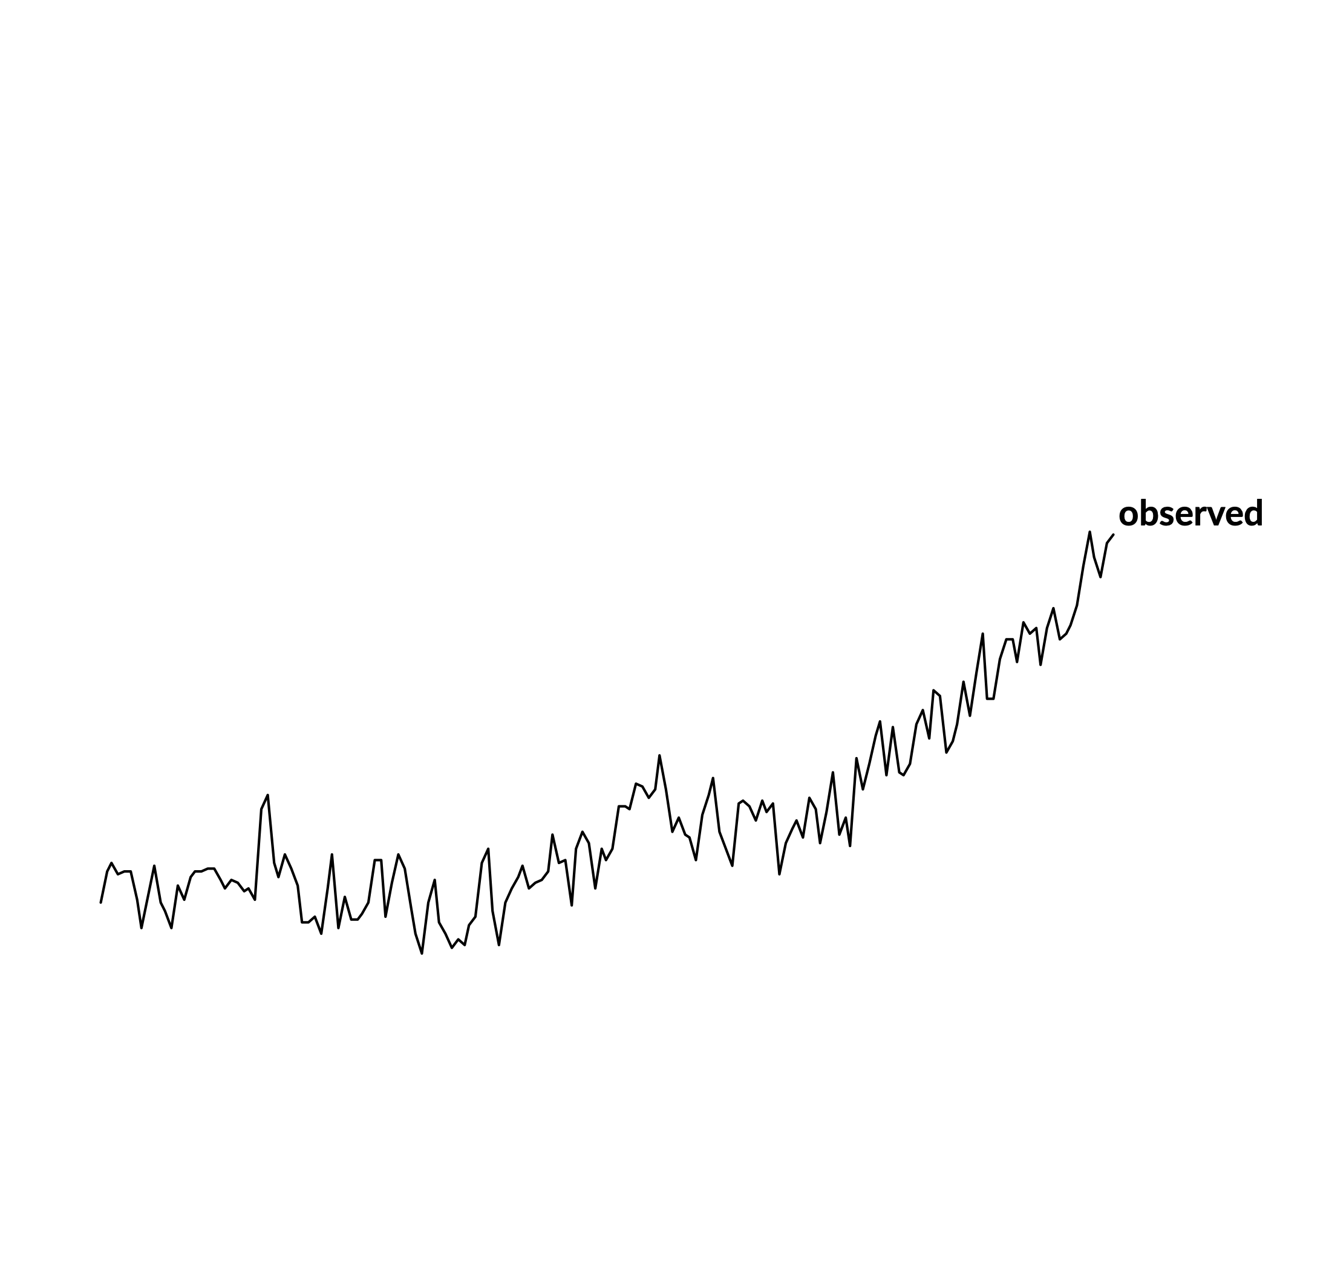
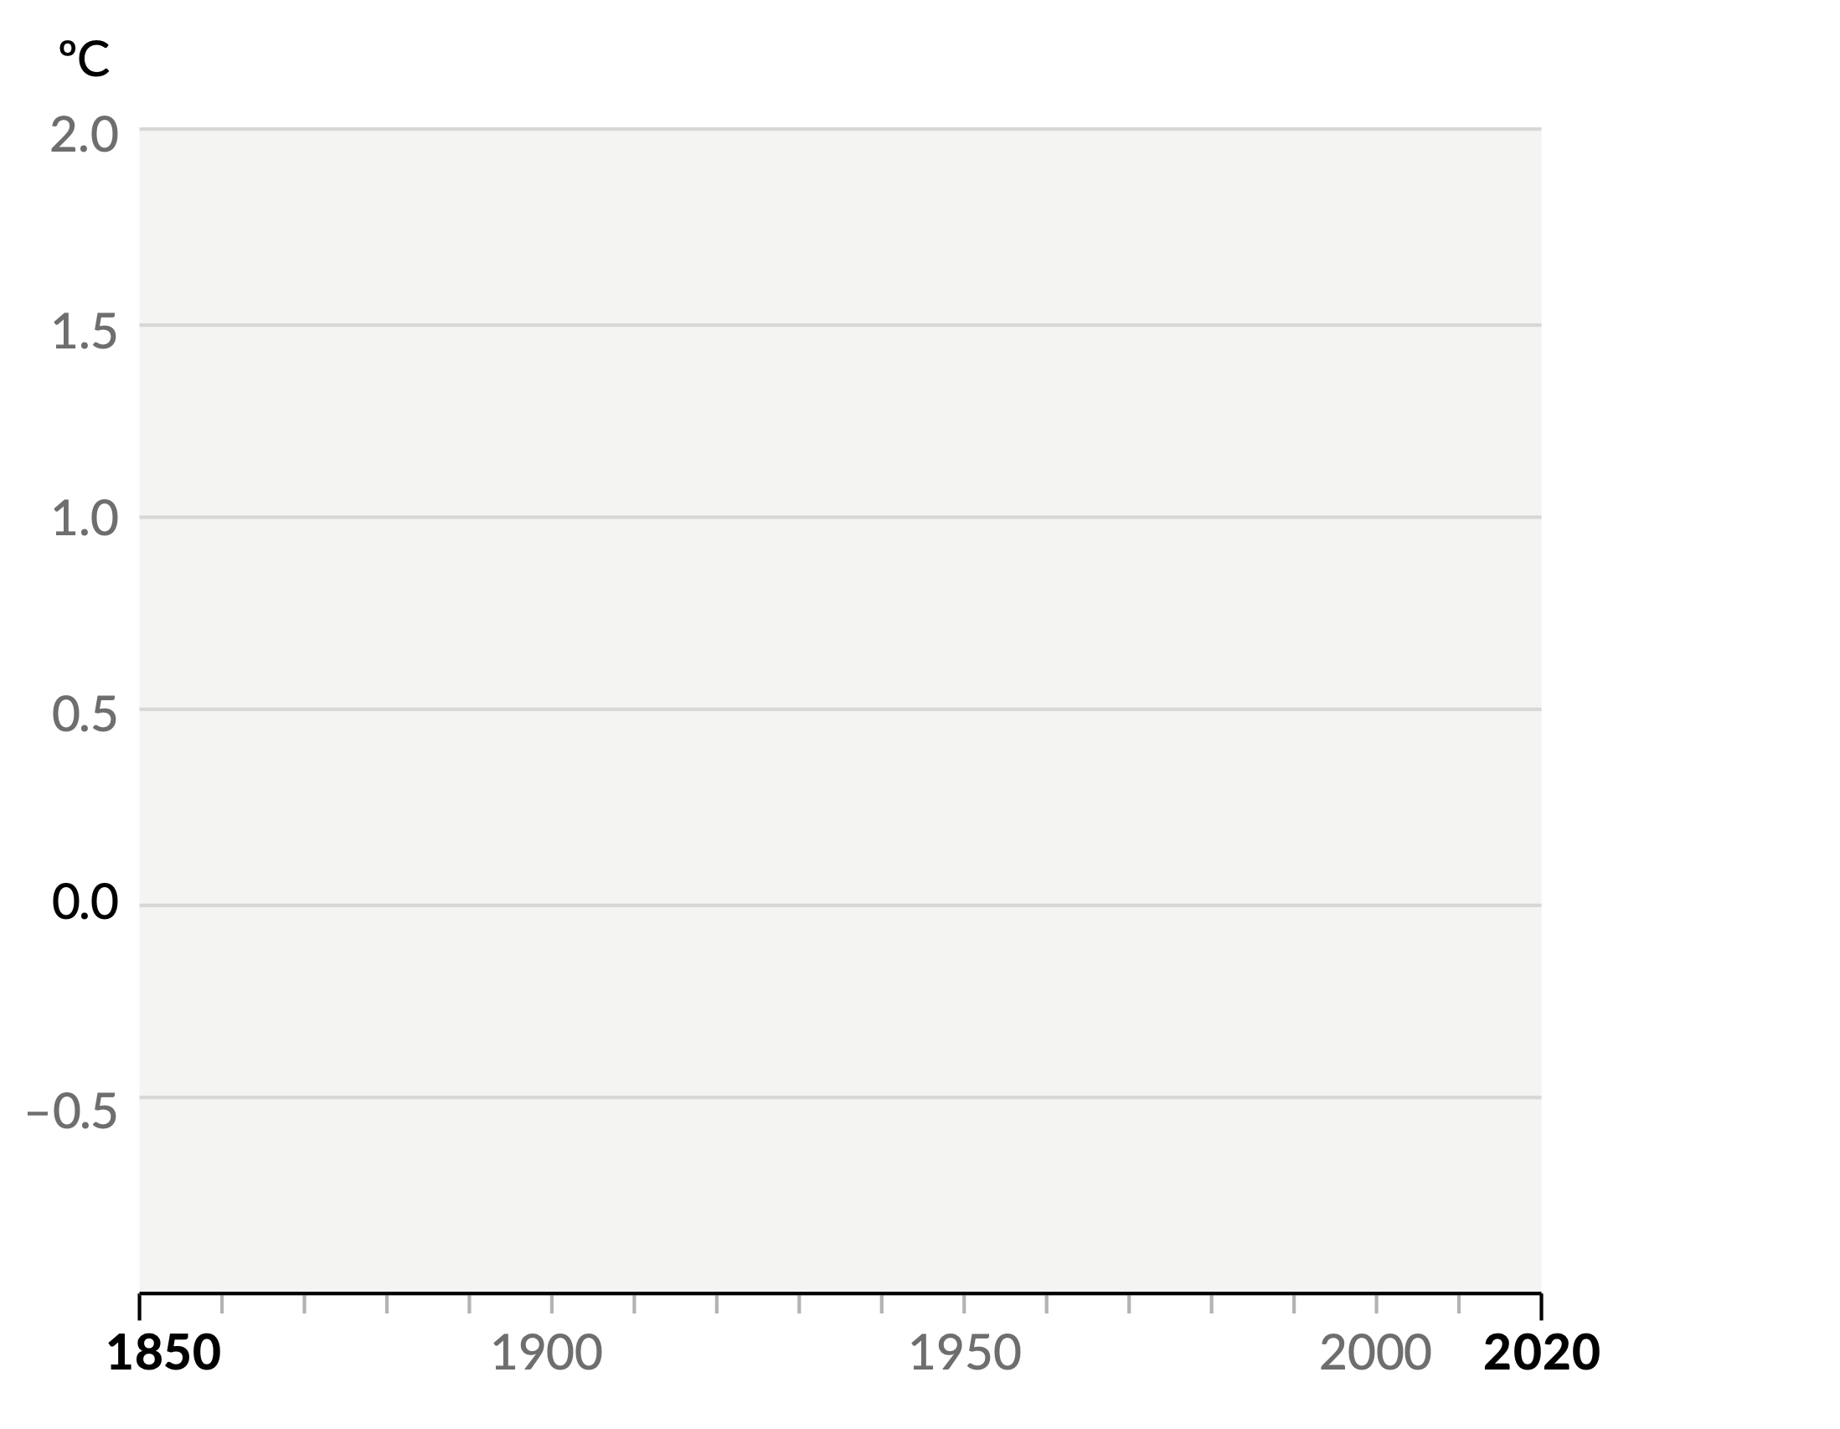
Figure SPM.1
Panel b
Change in global surface temperature (annual average) as observed and simulated using human & natural and only natural factors (1850-1900)
The climate is warming because of human activities
Current warming of 1.1°C
+1.1°C
Notes:
Having a closer look at the change in global surface temperature observed in the last 170 years:
[click - observed temperature - black line]
Over the last decade, global surface temperature has become 1.1°C warmer than the period 1850-1900. This compares today’s global surface temperature with pre-industrial levels.
Each of the last four decades has been successively warmer than any decade that came before it since 1850.
To understand what is causing this warming, we use computer models that simulate the global surface temperature.

Slide 7
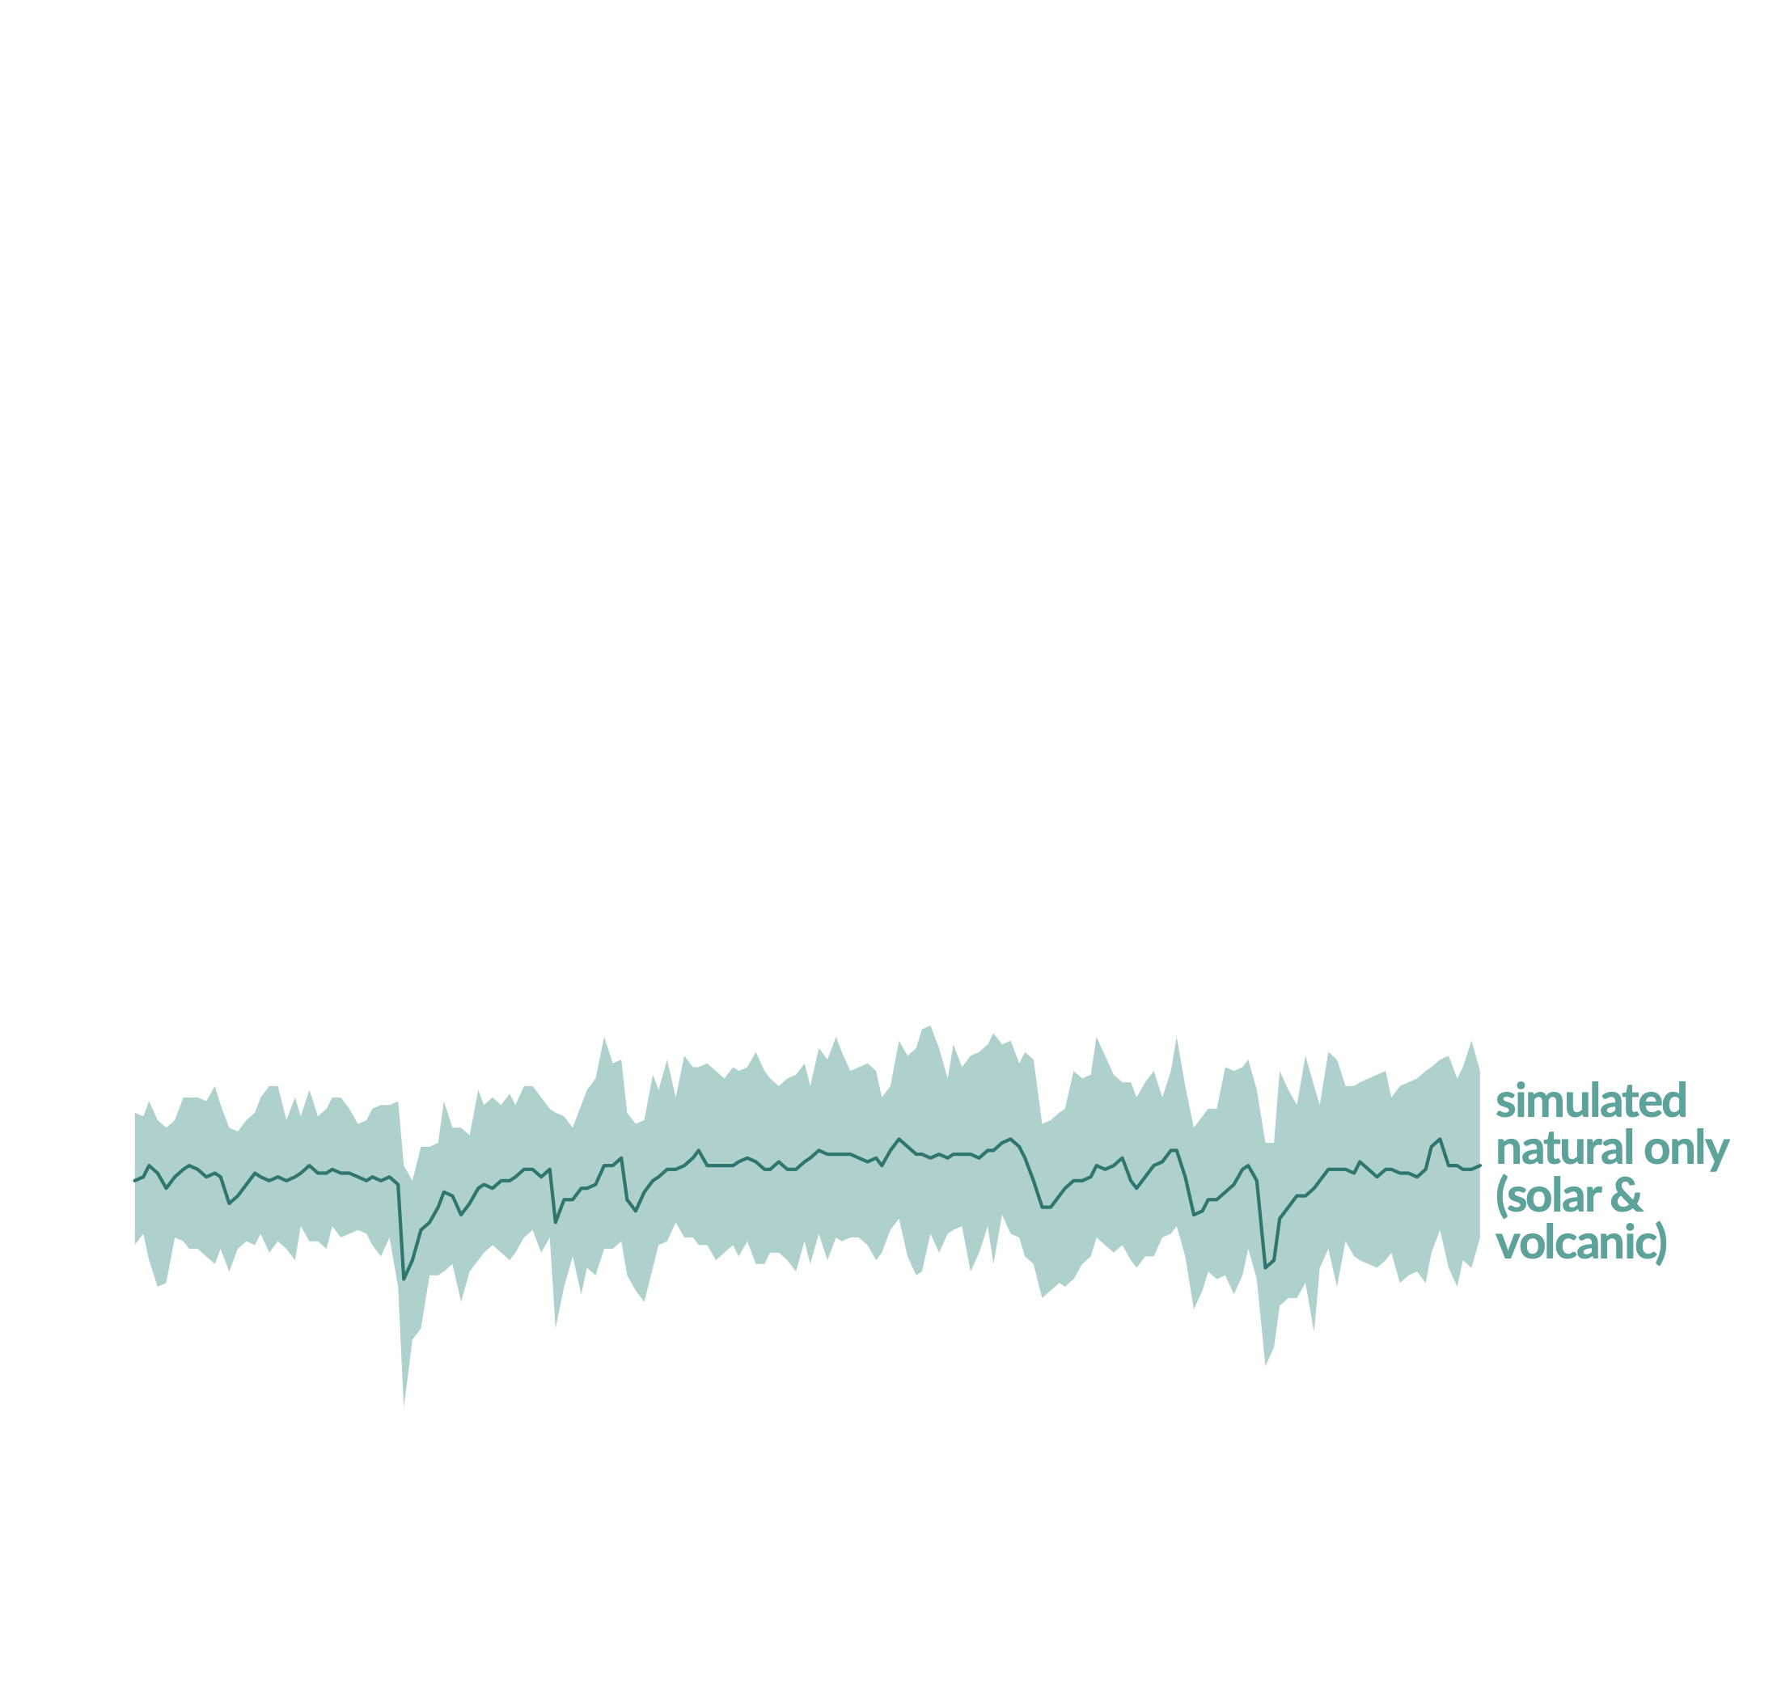
Figure SPM.1
Panel b
Change in global surface temperature (annual average) as observed and simulated using human & natural and only natural factors (1850-1900)
The climate is warming because of human activities
Current warming of 1.1°C
Natural factors are not causing this warming
Notes:
[simulated temperature with natural factors only - green line]
Earth’s climate can fluctuate due to natural factors, such as volcanic eruptions or the sun's activity.
The global warming we observe since 1850 is not caused by such natural events.

Slide 8
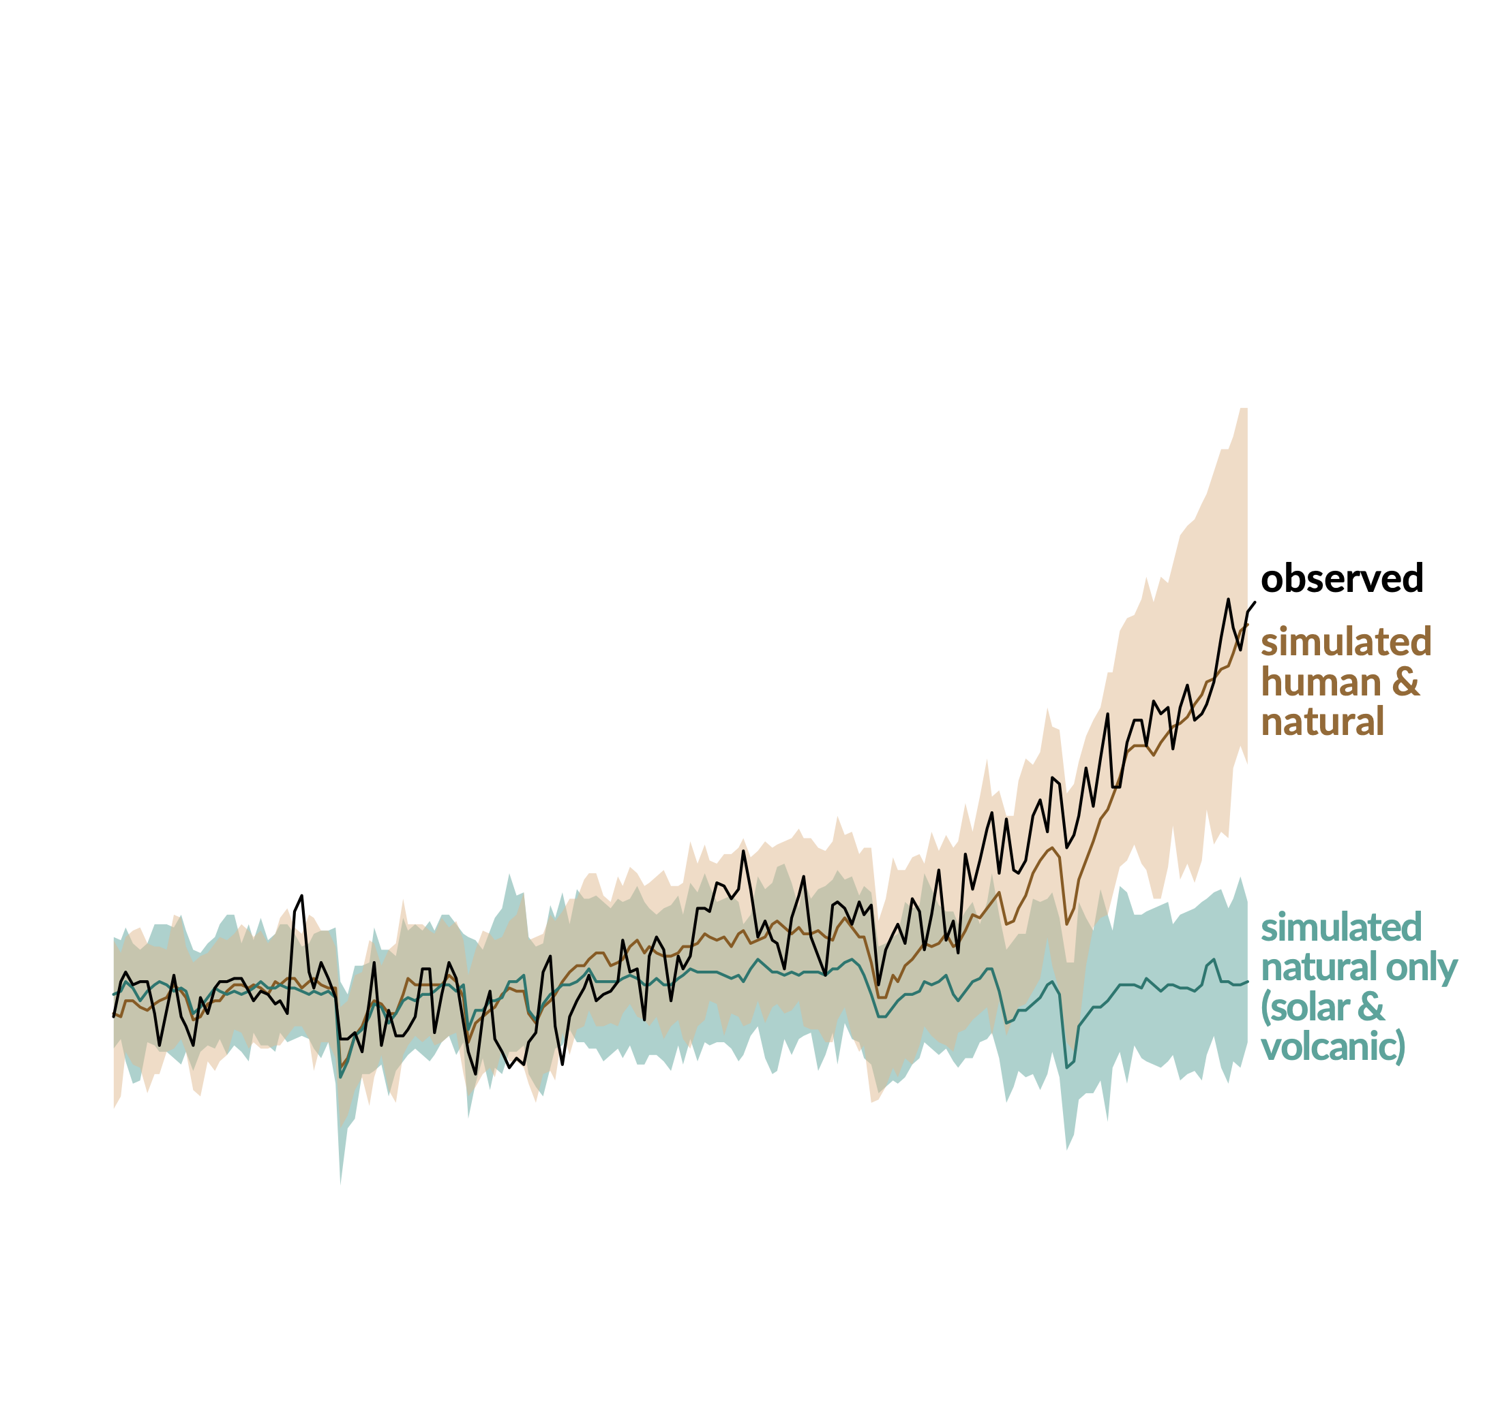
Figure SPM.1
Panel b
Change in global surface temperature (annual average) as observed and simulated using human & natural and only natural factors (1850-1900)
The climate is warming because of human activities
Current warming of 1.1°C
Natural factors are not causing this warming
Notes:
[simulated temperature including human and natural factors - brown line]
Today’s warming is caused by human activities emitting greenhouse gases from burning fossil fuels and land use change.
Greenhouse gases trap heat in the atmosphere cause an imbalance of the Earth’s energy budget, heating the climate system.
Human activities have warmed the climate over the last 170 years.

