Slide 1
Figure SPM.10
Future emissions will determine future warming

Slide 2
Figure SPM.10
Every tonne of CO₂ emissions adds to global warming

Slide 3
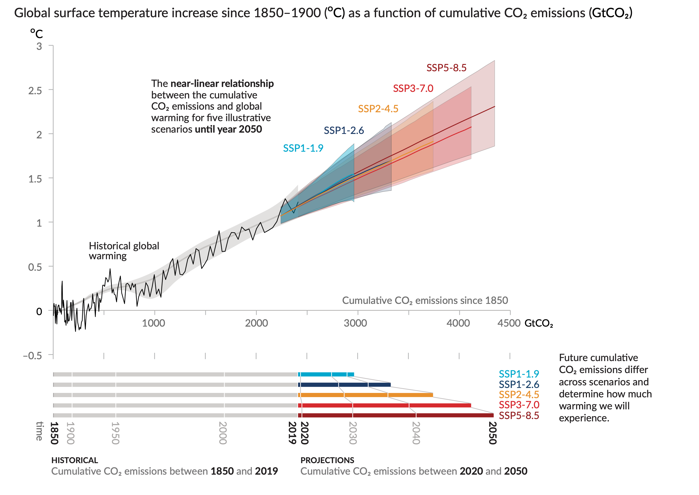
Figure SPM.10
Every tonne of CO₂ emissions adds to global warming
Notes:
The intent of this figure is to show that every tonne of CO2 emissions adds to global warming.
-----------------------------------Caption-----------------------
Figure SPM.10 | Near-linear relationship between cumulative CO2 emissions and the increase in global surface temperature
Top panel: Historical data (thin black line) shows observed global surface temperature increase in °C since 1850–1900 as a function of historical cumulative carbon dioxide (CO2) emissions in GtCO2 from 1850 to 2019. The grey range with its central line shows a corresponding estimate of the historical human-caused surface warming (see Figure SPM.2). Coloured areas show the assessed very likely range of global surface temperature projections, and thick coloured central lines show the median estimate as a function of cumulative CO2 emissions from 2020 until year 2050 for the set of illustrative scenarios (SSP1-1.9, SSP1-2.6, SSP2-4.5, SSP3-7.0, and SSP5-8.5; see Figure SPM.4). Projections use the cumulative CO2 emissions of each respective scenario, and the projected global warming includes the contribution from all anthropogenic forcers. The relationship is illustrated over the domain of cumulative CO2 emissions for which there is high confidence that the transient climate response to cumulative CO2 emissions (TCRE) remains constant, and for the time period from 1850 to 2050 over which global CO2 emissions remain net positive under all illustrative scenarios, as there is limited evidence supporting the quantitative application of TCRE to estimate temperature evolution under net negative CO2 emissions.
Bottom panel: Historical and projected cumulative CO2 emissions in GtCO2 for the respective scenarios.
{Section 5.5, Figure 5.31, Figure TS.18}

Slide 4
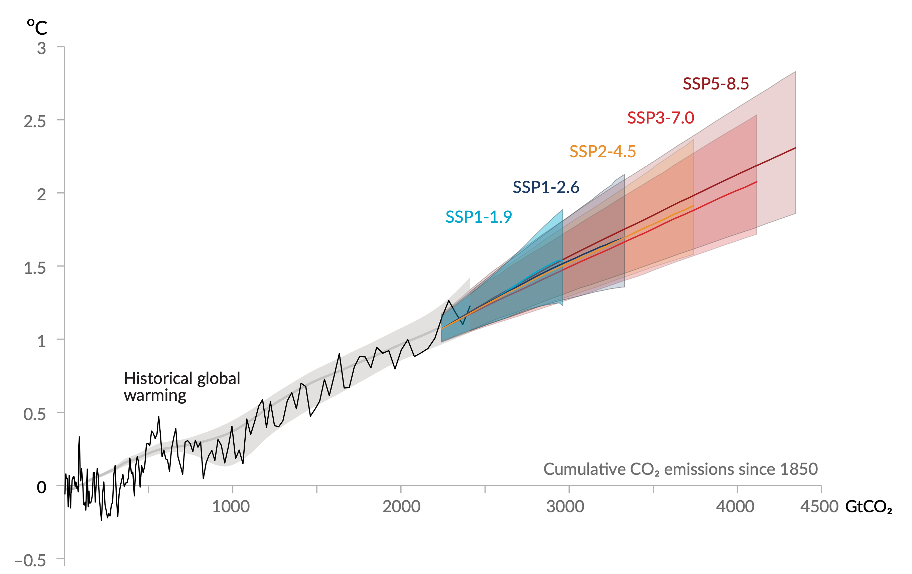
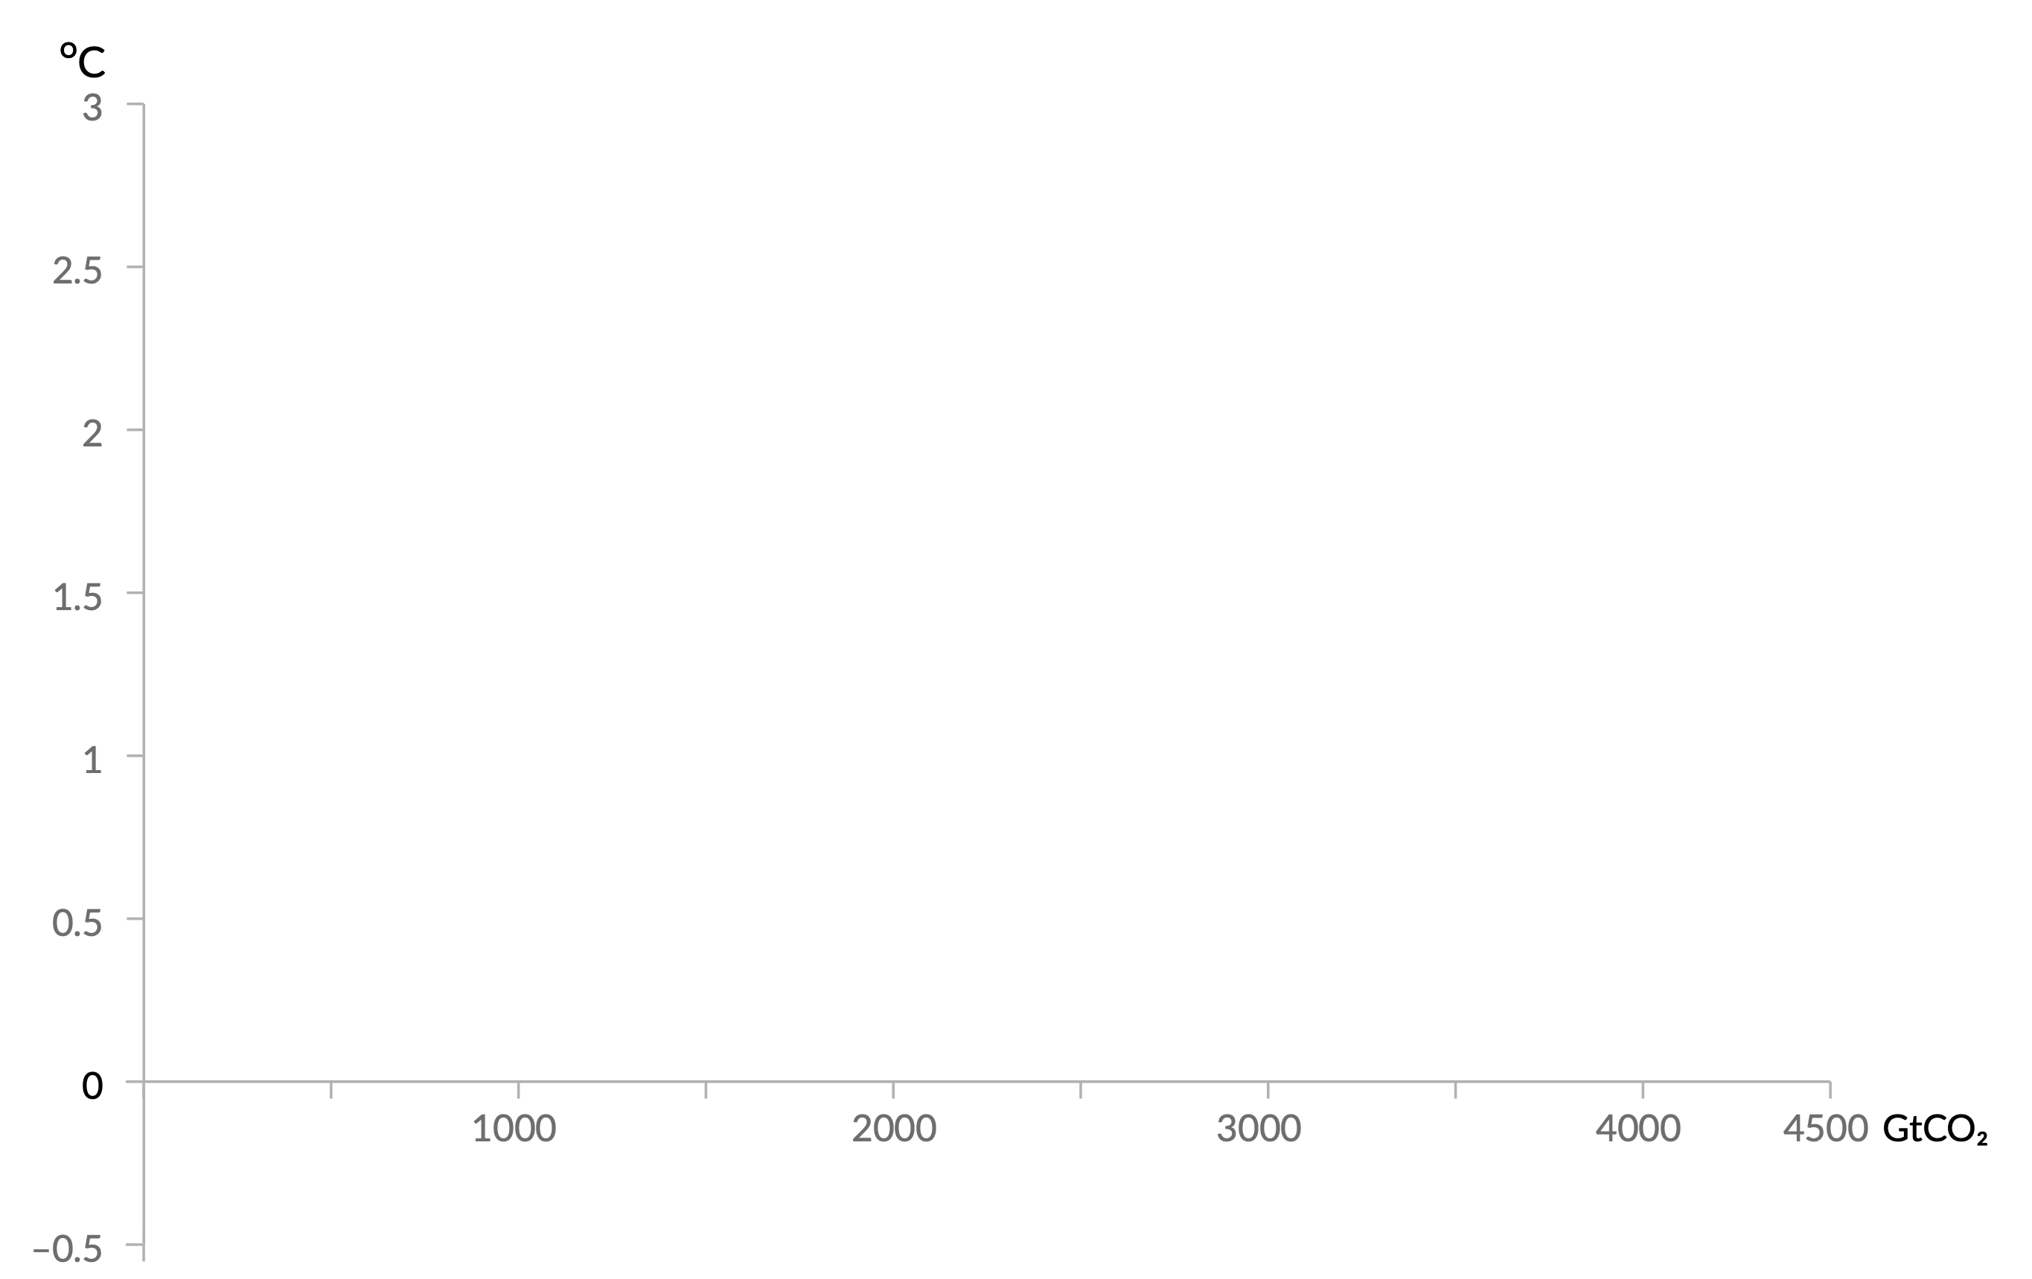
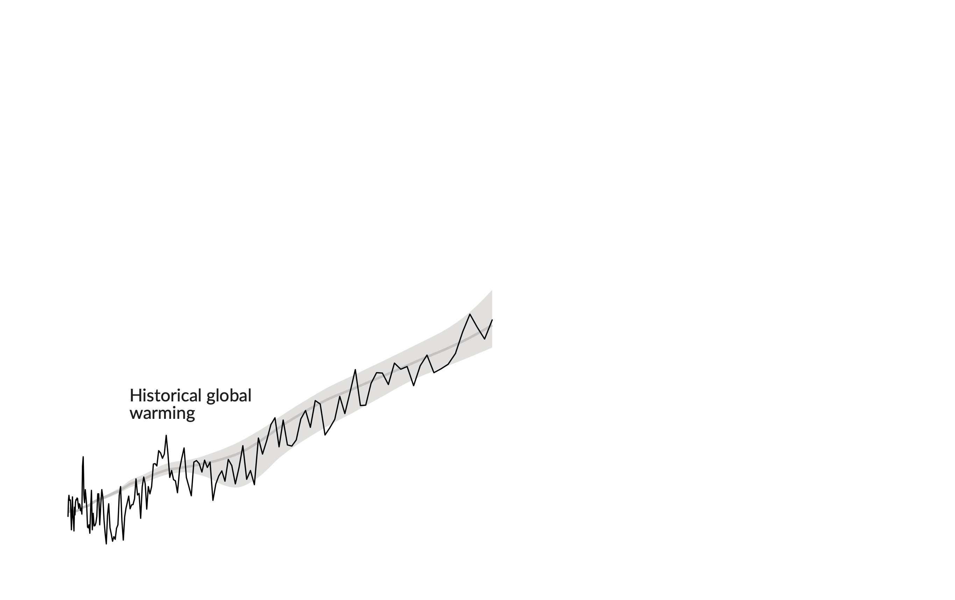
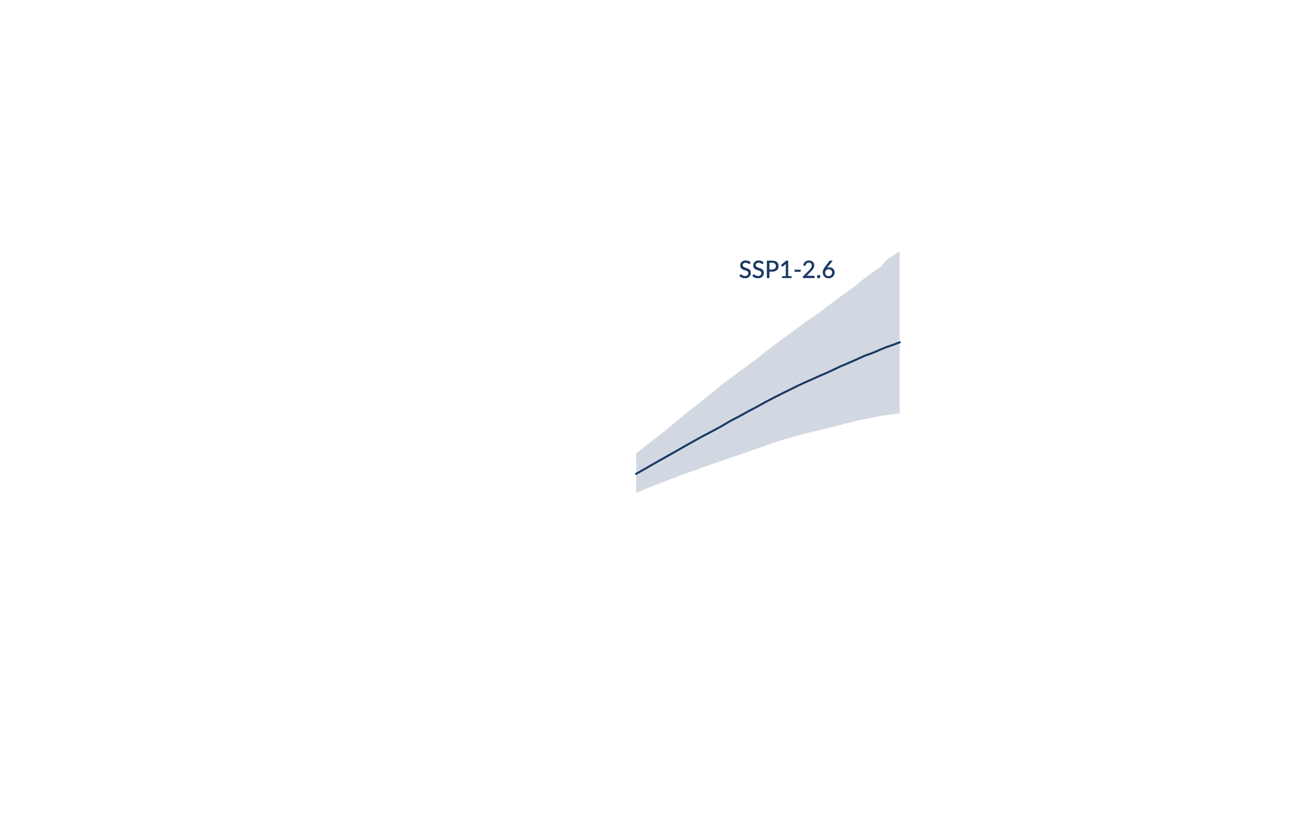
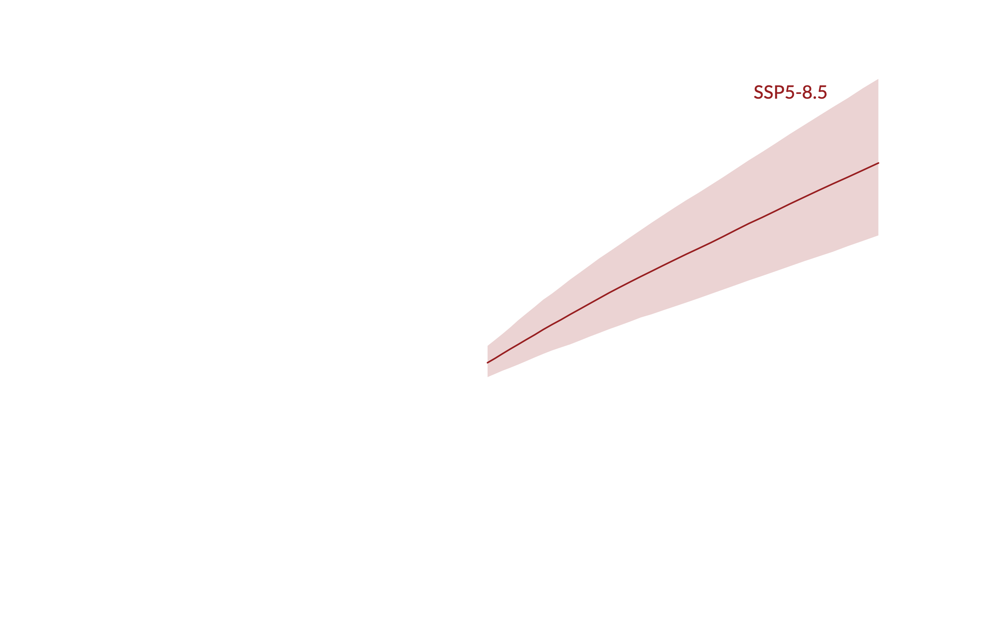
Figure SPM.10
Global surface temperature increase since 1850-1900 (°C) as a function of cumulative CO2 emissions (GtCO2)
A near linear relationship between cumulative CO2 emissions and global warming
Notes:
What the graph shows:
Global surface temperatures increase since 1850-1900 (Y axis) as a function of cumulative CO2 emissions (X axis).
Historical projections (grey area) and the historical global warming (black line)
[1 click per scenario, coloured cone] Projected CO2 emissions for the 5 illustrative scenarios assessed in this report.
Key messages:
There is a near linear relationship between cumulative CO2 emissions and global warming.
All the CO2 emitted in the past has led us to the global warming we have today.
Every tonne of CO2 that we will emit will warm the climate further.
Each 1000 GtCO2 of cumulative CO2 emissions is assessed to likely cause a 0.27°C to 0.63°C increase in global surface temperature with a best estimate of 0.45°C.
Limiting global warming requires limiting cumulative CO2 emissions, reaching at least net zero CO2 and strong reductions in other greenhouse gas emissions.
When emissions of CO2 reach net zero there is almost no more warming expected.
Limiting global temperature increase to a specific level would imply limiting cumulative CO2 emissions to within a carbon budget.

Slide 5
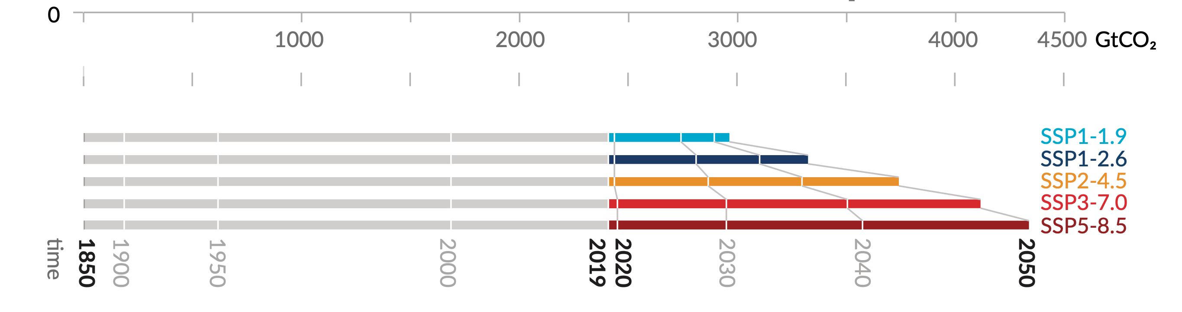
Figure SPM.10
Cumulative CO2 emissions since 1850 (GtCO2)
How much more warming we will experience in the future mostly depends on how large our future global CO2 emissions will be
Historical
Cumulative CO2 emissions between 1850 and 2019
Projections
Cumulative CO2 emissions between 2020-2050
Notes:
The bottom graph shows historical cumulative CO2 emissions since 1850 to 1950 and how future cumulative emissions differ across each illustrative scenario assessed in the report until 2050.
Key messages:
Over the period 1850 to 2019, a total of 2390 ± 240 GtCO2 of human-caused CO2 was emitted.
Future cumulative emissions of human-caused CO2 differ across the assessed scenarios and determine how much global warming we will experience.
Air pollution controls with strong and sustained reductions in methane emissions also contribute to limiting global warming, as well as improving air quality.
Every additional tonne of carbon dioxide emitted into the atmosphere matters.

