Slide 1

Figure SPM.2
Climate change is caused by humans

Slide 2
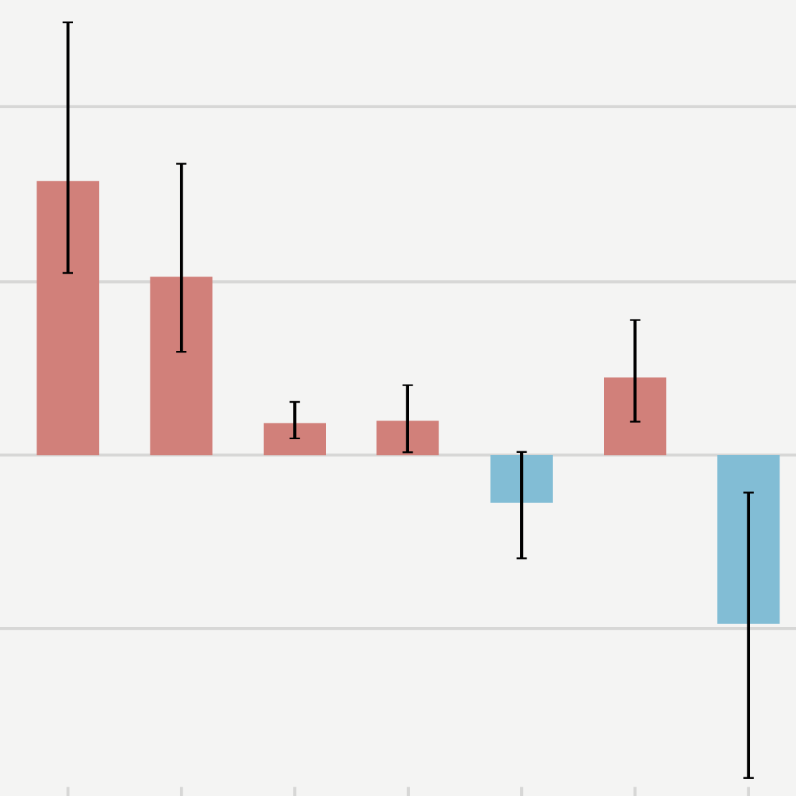
Figure SPM.2
Observed warming is driven by emissions from human activities, with greenhouse gas warming partly masked by aerosol cooling

Slide 3
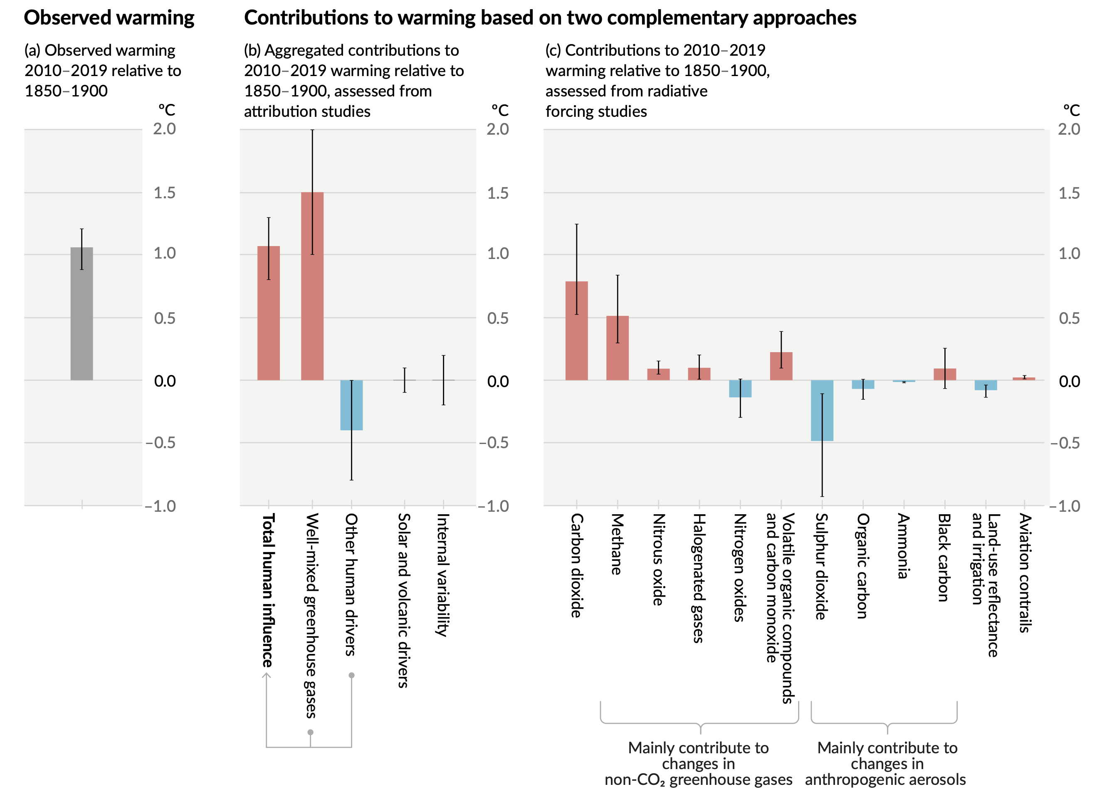
Figure SPM.2
Human influence on the climate system is now unequivocal
Observed warming is driven by emissions from human activities, with greenhouse gas warming partly masked by aerosol cooling
Notes:
The intent of this figure is to show that observed warming is driven by emissions from human activities, with greenhouse gas warming partly masked by the overall cooling effect of atmospheric pollution particles called aerosols.
In this report, we combine two complementary approaches, one from attribution studies, comparing simulations with and without human influence with the observed changes (central panel); and another one based on radiative forcing and climate sensitivity studies (right-hand panel).
Combining the evidence from across the climate system gives us greater confidence in the attribution of observed climate change to human influence. The human influence on the climate system is now unequivocal.
This figure has three important messages:
Current warming is all caused by humans activities and their associated greenhouse gas emissions – this is seen in panels a and b.
The warming effect of greenhouse gases would be greater than we have observed, but some of their warming is masked by the overall cooling effect of air pollutants (aerosols) – this is seen in panel b (the first three vertical bars).
Among all the greenhouse gases, carbon dioxide is the one contributing the most to the warming, followed by methane – this is seen in panel c (the first two vertical bars, respectively).
-----------------------------------Caption-----------------------
Figure SPM.2 | Assessed contributions to observed warming in 2010–2019 relative to 1850–1900
Panel (a) Observed global warming (increase in global surface temperature). Whiskers show the very likely range.
Panel (b) Evidence from attribution studies, which synthesize information from climate models and observations. The panel shows temperature change attributed to: total human influence; changes in well-mixed greenhouse gas concentrations; other human drivers due to aerosols, ozone and land-use change (land-use reflectance); solar and volcanic drivers; and internal climate variability. Whiskers show likely ranges.
Panel (c) Evidence from the assessment of radiative forcing and climate sensitivity. The panel shows temperature changes from individual components of human influence: emissions of greenhouse gases, aerosols and their precursors; land-use changes (land-use reflectance and irrigation); and aviation contrails. Whiskers show very likely ranges. Estimates account for both direct emissions into the atmosphere and their

Slide 4

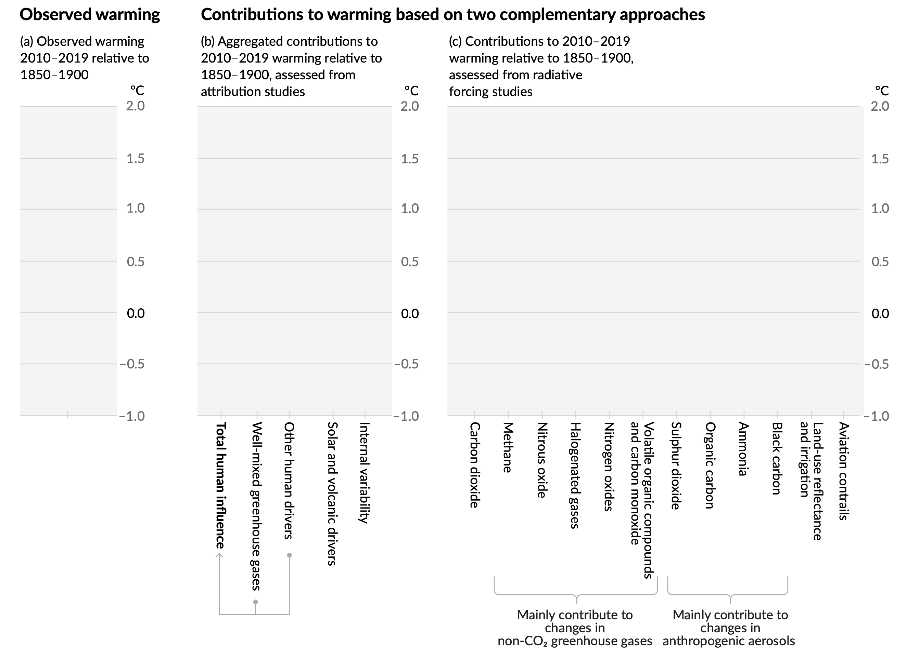
Figure SPM.2
Panel a
Observed warming
Message 1: Current warming is caused by human activities
Current warming of 1.1°C
Notes:
Message 1: Current warming is caused by human activities
Observed warming is shown by the vertical grey bar.
The Earth’s surface has warmed by 1.1°C since the late 19th century, compare to pre-industrial levels.

Slide 5


Figure SPM.2
Panel b
Observed warming
Contributions to warming
Message 1: Current warming is 100% caused by human activities
Current warming of 1.1°C
Natural factors are not causing this warming
Notes:
Message 1: Global warming is 100% caused by humans
[click] The observed warming is caused by human activities, shown by the vertical red bar.
[click] Natural factors (solar variations, volcanic eruptions, internal climate variability) that influence the climate over decades do not affect the observed warming over hundreds of years (see the grey whiskers indicated by the red arrows).
[click] Observed increases in greenhouse gas concentrations since around 1750 are unequivocally caused by human activities.

Slide 6


Figure SPM.2
Panel b
Observed warming
Contributions to warming
Message 2: The warming effect of greenhouse gases is partly masked by air pollutants that have a cooling effect
Notes:
Message 2: The warming effect of greenhouse gases is partly masked by air pollutants that have a cooling effect.
The warming effect caused by greenhouse gases (vertical red bar)
[click] is partly masked by an overall cooling effect caused by air pollutants (aerosols, ozone) and land-use changes (vertical blue bar)
Greenhouse gases are well-mixed throughout the atmosphere while air pollutants are concentrated around cities and industrial areas, and can be washed out of the atmosphere rapidly by precipitation.

Slide 7

Figure SPM.2
Panel c
Observed warming
Contributions to warming
Message 3: Among all the greenhouse gases, carbon dioxide is the one contributing the most to warming, followed by methane
Notes:
Message 3: Among all the greenhouse gases, carbon dioxide is the one contributing the most to warming, with a strong contribution also from methane (indicated by the red arrows)
We have an improved understanding of the role of each individual component of human influence from carbon dioxide, other greenhouse gases, and pollutants (or aerosols).
After carbon dioxide, the second largest contribution is from methane. This is related to its direct and indirect effect (through the formation of ozone which is both a pollutant and greenhouse gas).

