Slide 1
Figure SPM.4
We can define our future

Slide 2
Figure SPM.4
Future emissions cause future additional warming, with total warming dominated by past and future CO2 emissions

Slide 3
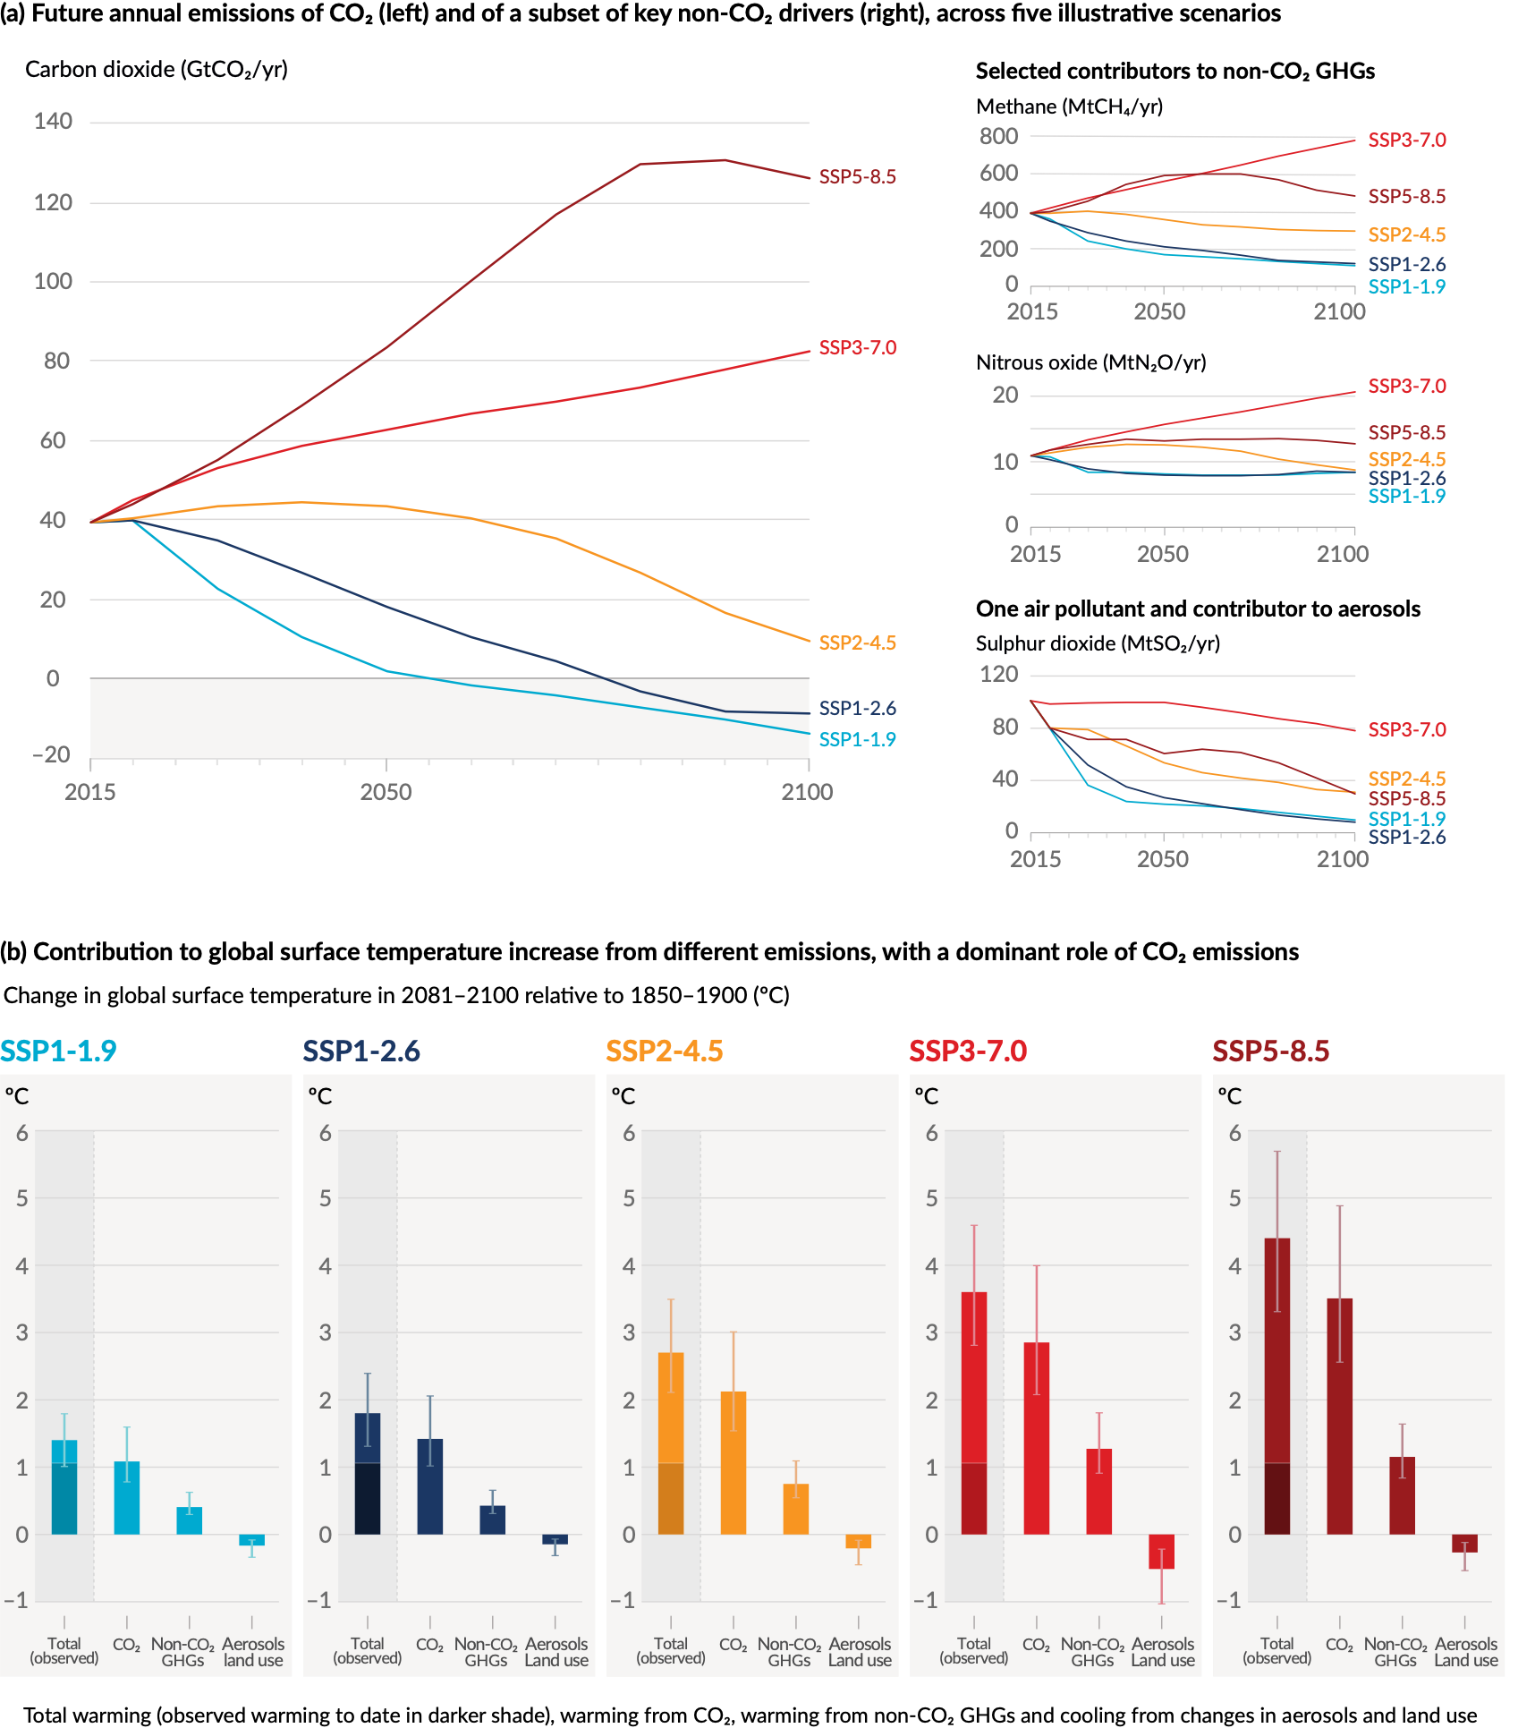
Figure SPM.4
Future emissions cause future additional warming, with total warming dominated by past and future CO2 emissions
Notes:
The intent of this figure is to show that future emissions cause future additional warming, with total warming dominated by past and future CO2 emissions.
This figure includes three important messages:
Different possible future emissions scenarios lead to different levels of future global warming, depending on how much greenhouse gases and air pollutants will be emitted – this is shown in panel a.
Future global warming depends on future emissions – the more we emit, the more the surface of the Earth will warm – this is shown in panel b.
Global warming is predominantly caused by emissions of carbon dioxide, with a strong contribution also from methane. The total warming is partly masked by the cooling effect of pollutants (aerosols) and changes in land use.
Future warming continues unless human-caused emissions balance overall to zero, in other words, unless net zero carbon emissions occur.
-----------------------------------Caption-----------------------
Figure SPM.4 | Future anthropogenic emissions of key drivers of climate change and warming contributions by groups of drivers for the five illustrative scenarios used in this report
The five scenarios are SSP1-1.9, SSP1-2.6, SSP2-4.5, SSP3-7.0 and SSP5-8.5.
Panel (a) Annual anthropogenic (human-caused) emissions over the 2015–2100 period. Shown are emissions trajectories for carbon dioxide (CO2) from all sectors (GtCO2/yr) (left graph) and for a subset of three key non-CO2 drivers considered in the scenarios: methane (CH4, MtCH4/yr, top-right graph); nitrous oxide (N2O, MtN2O/yr, middle-right graph); and sulphur dioxide (SO2, MtSO2/yr, bottom-right graph, contributing to anthropogenic aerosols in panel (b).
Panel (b) Warming contributions by groups of anthropogenic drivers and by scenario are shown as the change in global surface temperature (°C) in 2081–2100 relative to 1850–1900, with indication of the observed warming to date. Bars and whiskers represent median values and the very likely range, respectively. Within each scenario bar plot, the bars represent: total global warming (°C; ‘total’ bar) (see Table SPM.1); warming contributions (°C) from changes in CO2 (‘CO2’ bar) and from non-CO2 greenhouse gases (GHGs; ‘non-CO2 GHGs’ bar: comprising well-mixed greenhouse gases and ozone); and net cooling from other anthropogenic drivers (‘aerosols and land use’ bar: anthropogenic aerosols, changes in reflectance due to land-use and irrigation changes, and contrails from aviation) (see Figure SPM.2, panel c, for the warming contributions to date for individual drivers). The best estimate for observed warming in 2010–2019 relative to 1850–1900 (see Figure SPM.2, panel a) is indicated in the darker column in the ‘total’ bar. Warming contributions in panel (b) are calculated as explained in Table SPM.1 for the total bar. For the other bars, the contribution by groups of drivers is calculated with a physical climate emulator of global surface temperature that relies on climate sensitivity and radiative forcing assessments.
{Cross-Chapter Box 1.4; 4.6; Figure 4.35; 6.7; Figures 6.18, 6.22 and 6.24; 7.3; Cross-Chapter Box 7.1; Figure 7.7; Box TS.7; Figures TS.4 and TS.15}

Slide 4
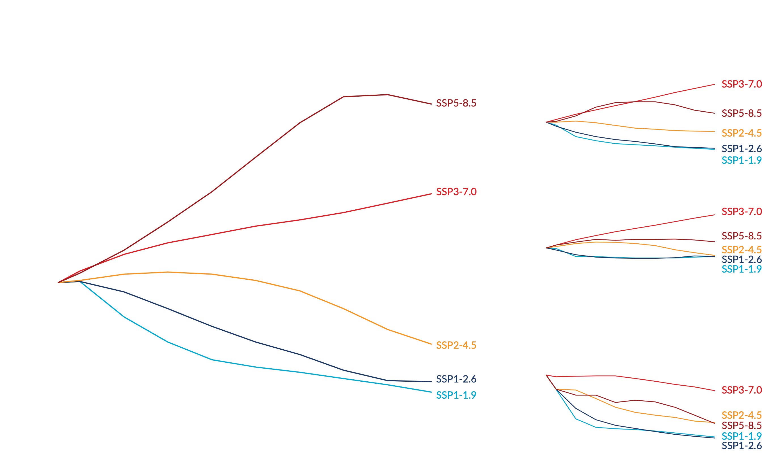
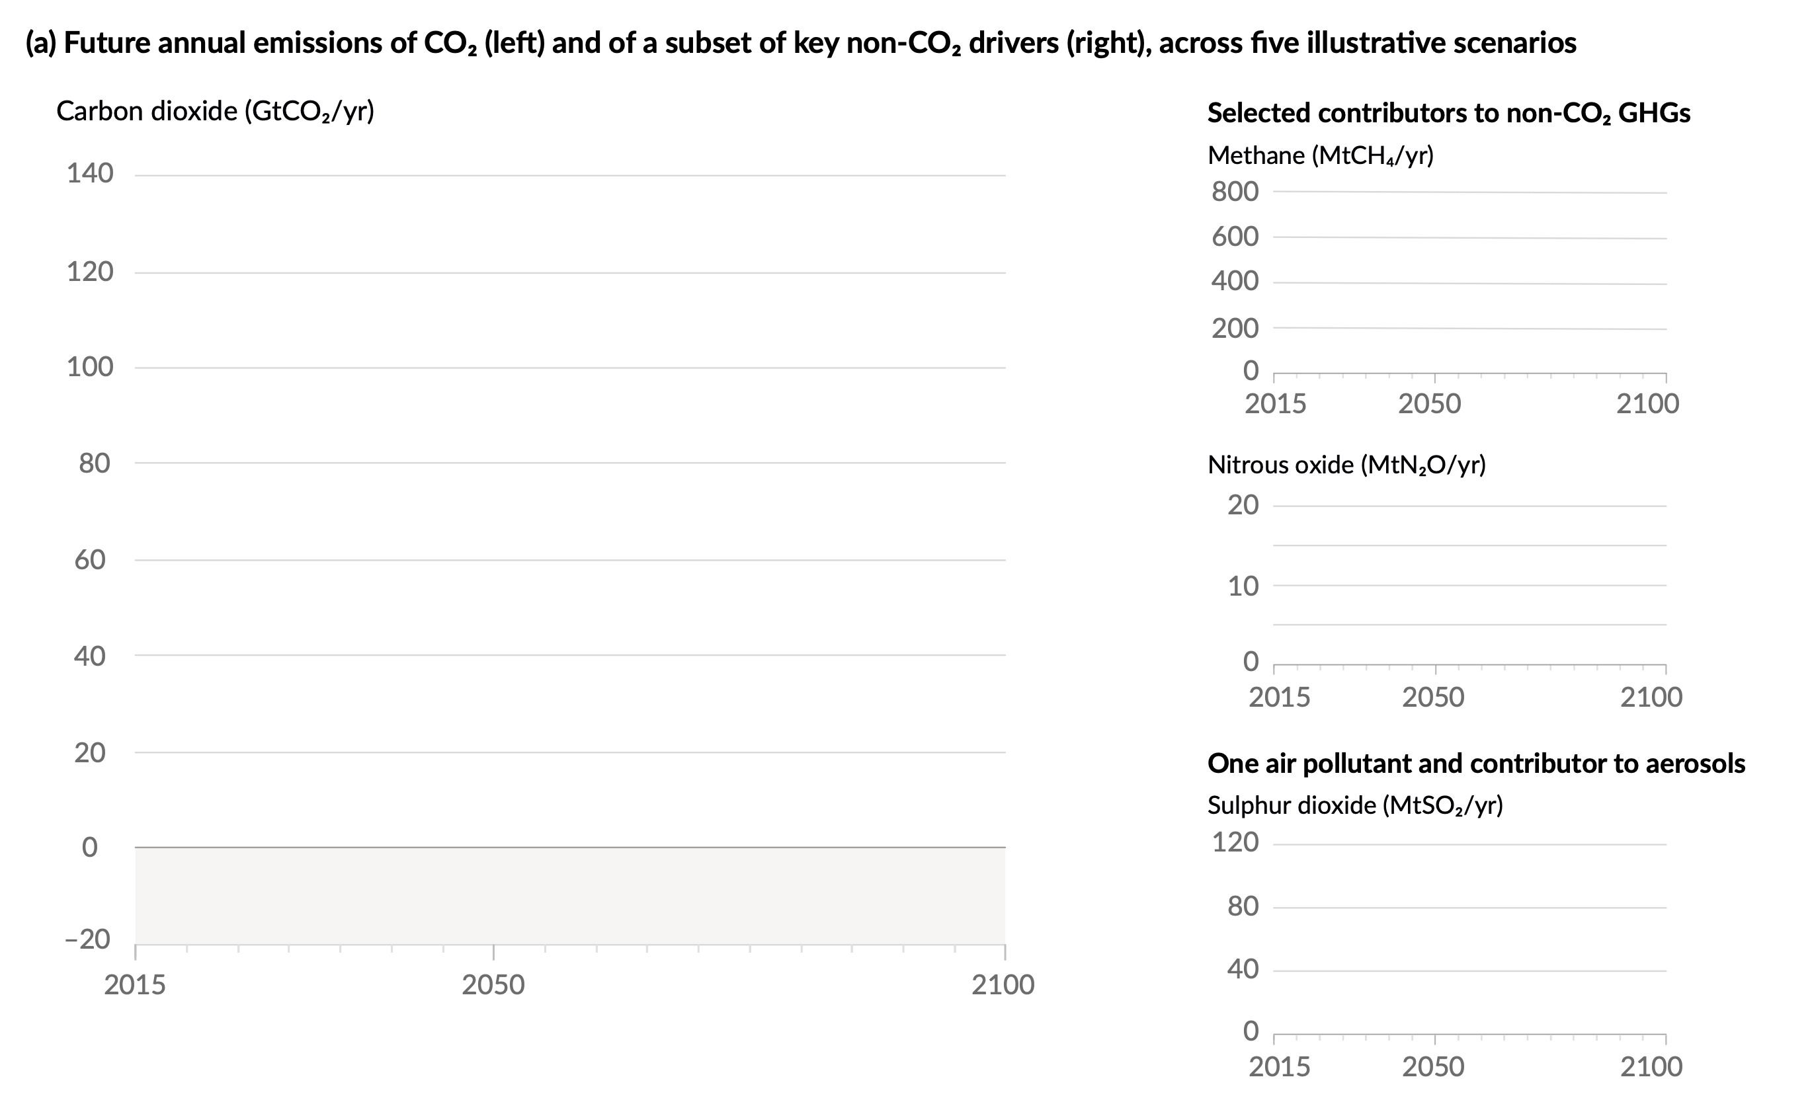
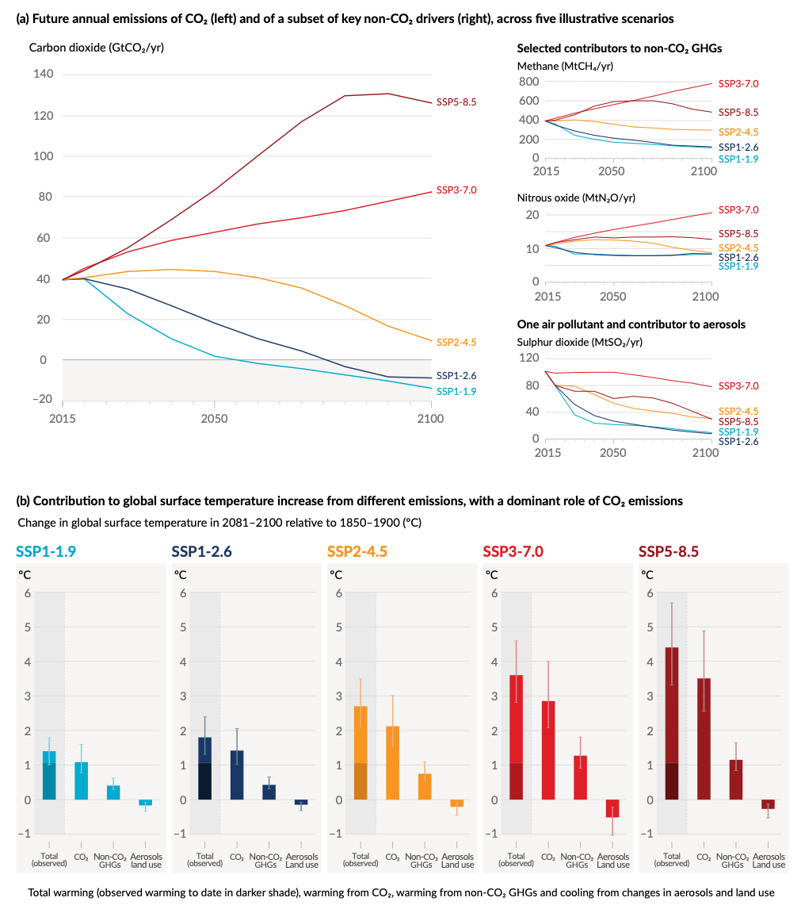
Figure SPM.4
Panel a
Possible future emissions scenarios of carbon dioxide, other greenhouse gases, and air pollutants
Message 1: Different possible future emissions scenarios lead to different levels of future global warming
Notes:
Message 1: Different possible future emissions scenarios lead to different levels of future global warming, depending on how much greenhouse gases and air pollutants (aerosols) will be emitted.
In the AR6 Working Group I report, five illustrative emissions scenarios are used to assess possible climate futures.
They span a broader range of greenhouse gas and air pollutant futures than assessed in earlier WGI reports
The illustrative scenarios are based on future trajectories of different combinations of greenhouse gases (GHGs) and air pollutant emissions.
SSP3-7.0 and SSP5-8.5 represent high CO2-emission pathways without any climate change mitigation, SSP2-4.5 is the intermediate CO2-emission pathway, and SSP1-1.9 and SSP1-2.6 represent low CO2 emission pathways. Non CO2 emissions vary between scenarios and depend on levels of climate change mitigation and air pollution control.
The intermediate emissions scenario is close to a scenario with current climate policies in place, as assessed by Working Group III.
We then look at how much global warming these scenarios lead to (this is illustrated in panel b).

Slide 5
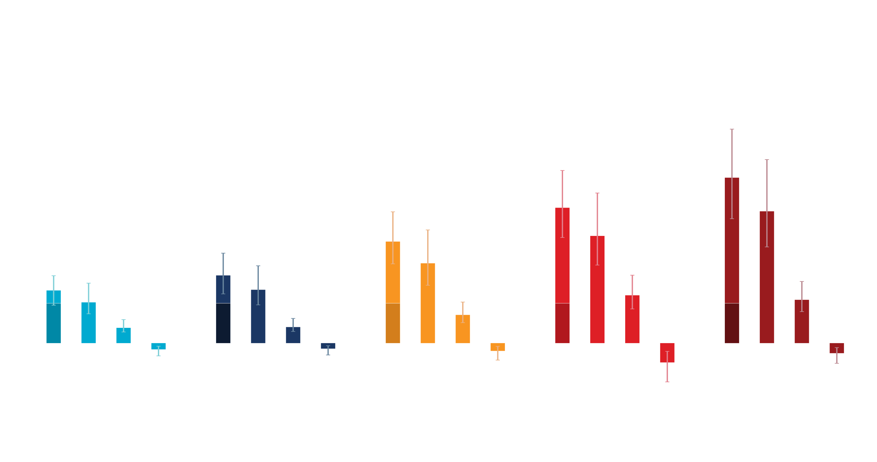
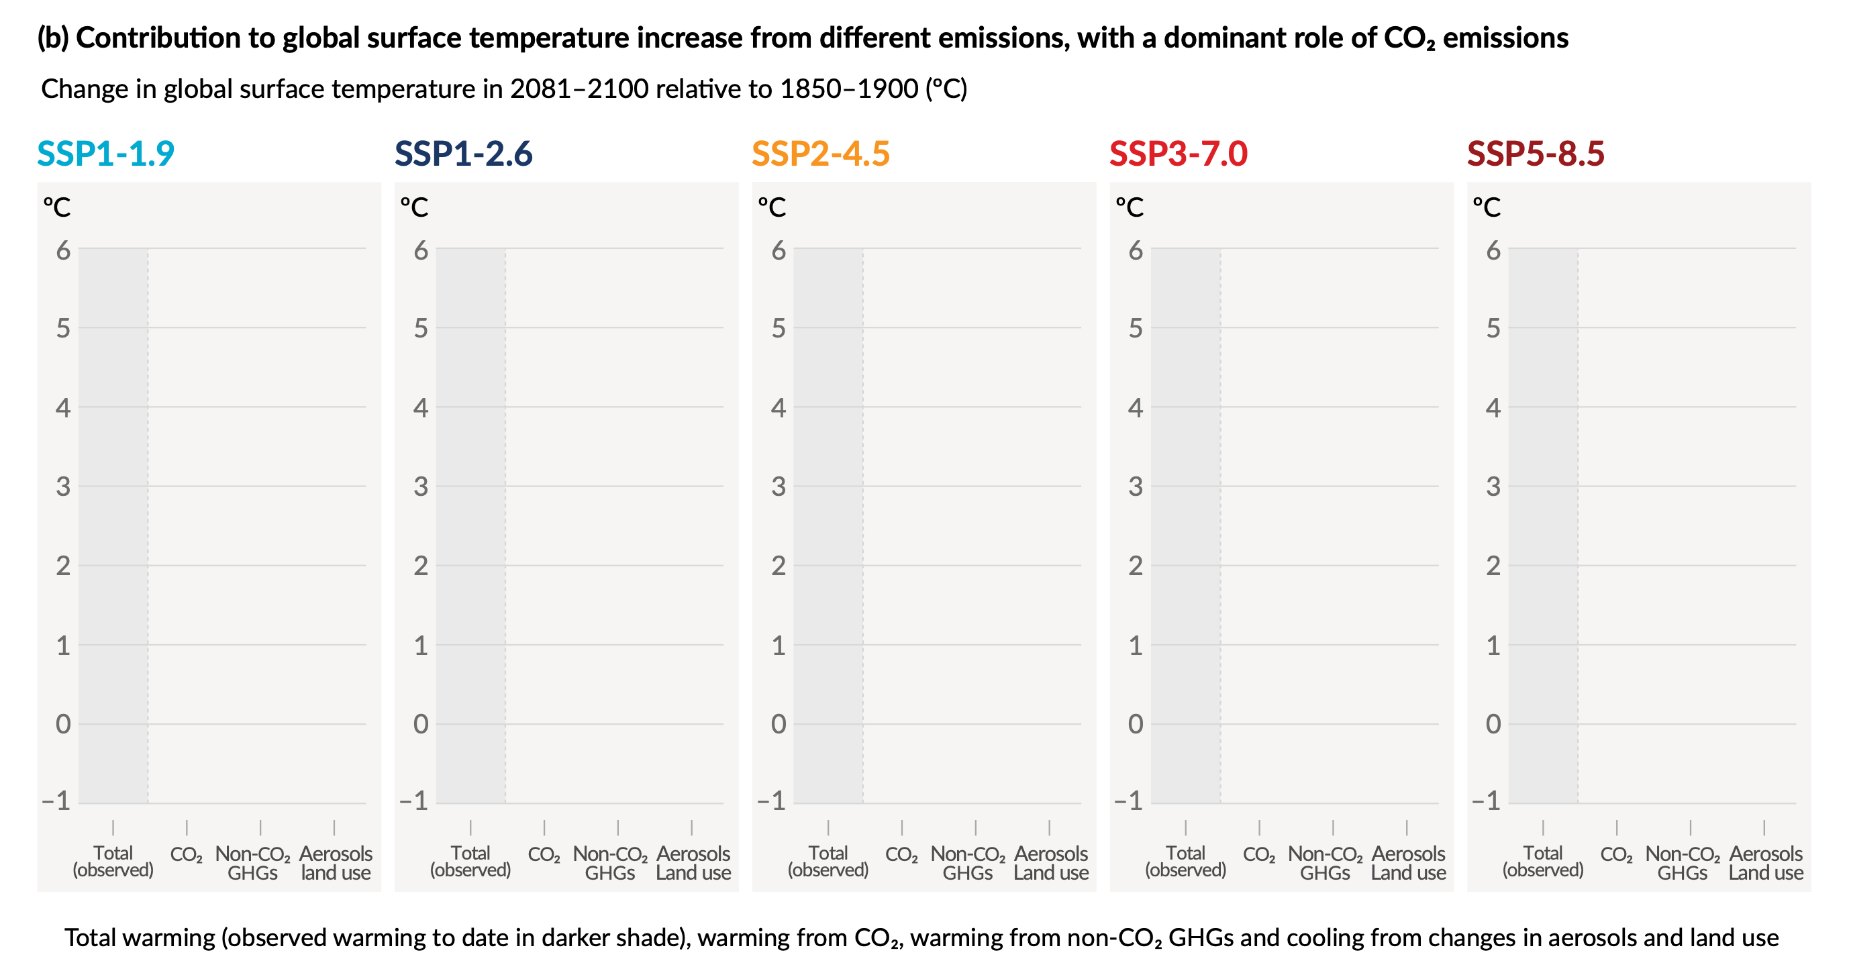
Figure SPM.4
Panel b
Contribution to global surface temperature increase from different emissions, with a dominant role of CO2 emissions
Message 2: Future global warming depends on how much will be emitted in the future
Change in 2081-2100 relative to 1850-1900 (°C)
Total warming (observed warming to date in darker shade), warming from CO2 and non-CO2 GHGs, and cooling from changes in aerosols and land use
Notes:
Message 2: Future global warming depends on how much will be emitted in the future.
The far left vertical bar for each assessed emissions scenario shows the change in global surface temperature at the end of this century compared to pre-industrial levels (1850-1900).
[click, step 1] The dark bars show today’s observed warming of 1.1°C above pre-industrial levels (1850-1900).
This warming is the result of past emissions.
[click, step 2] The more we emit in the future, the larger the global warming we will experience in the future (but the end of this century).
The more we emit, the more the surface of the Earth will warm.

Slide 6
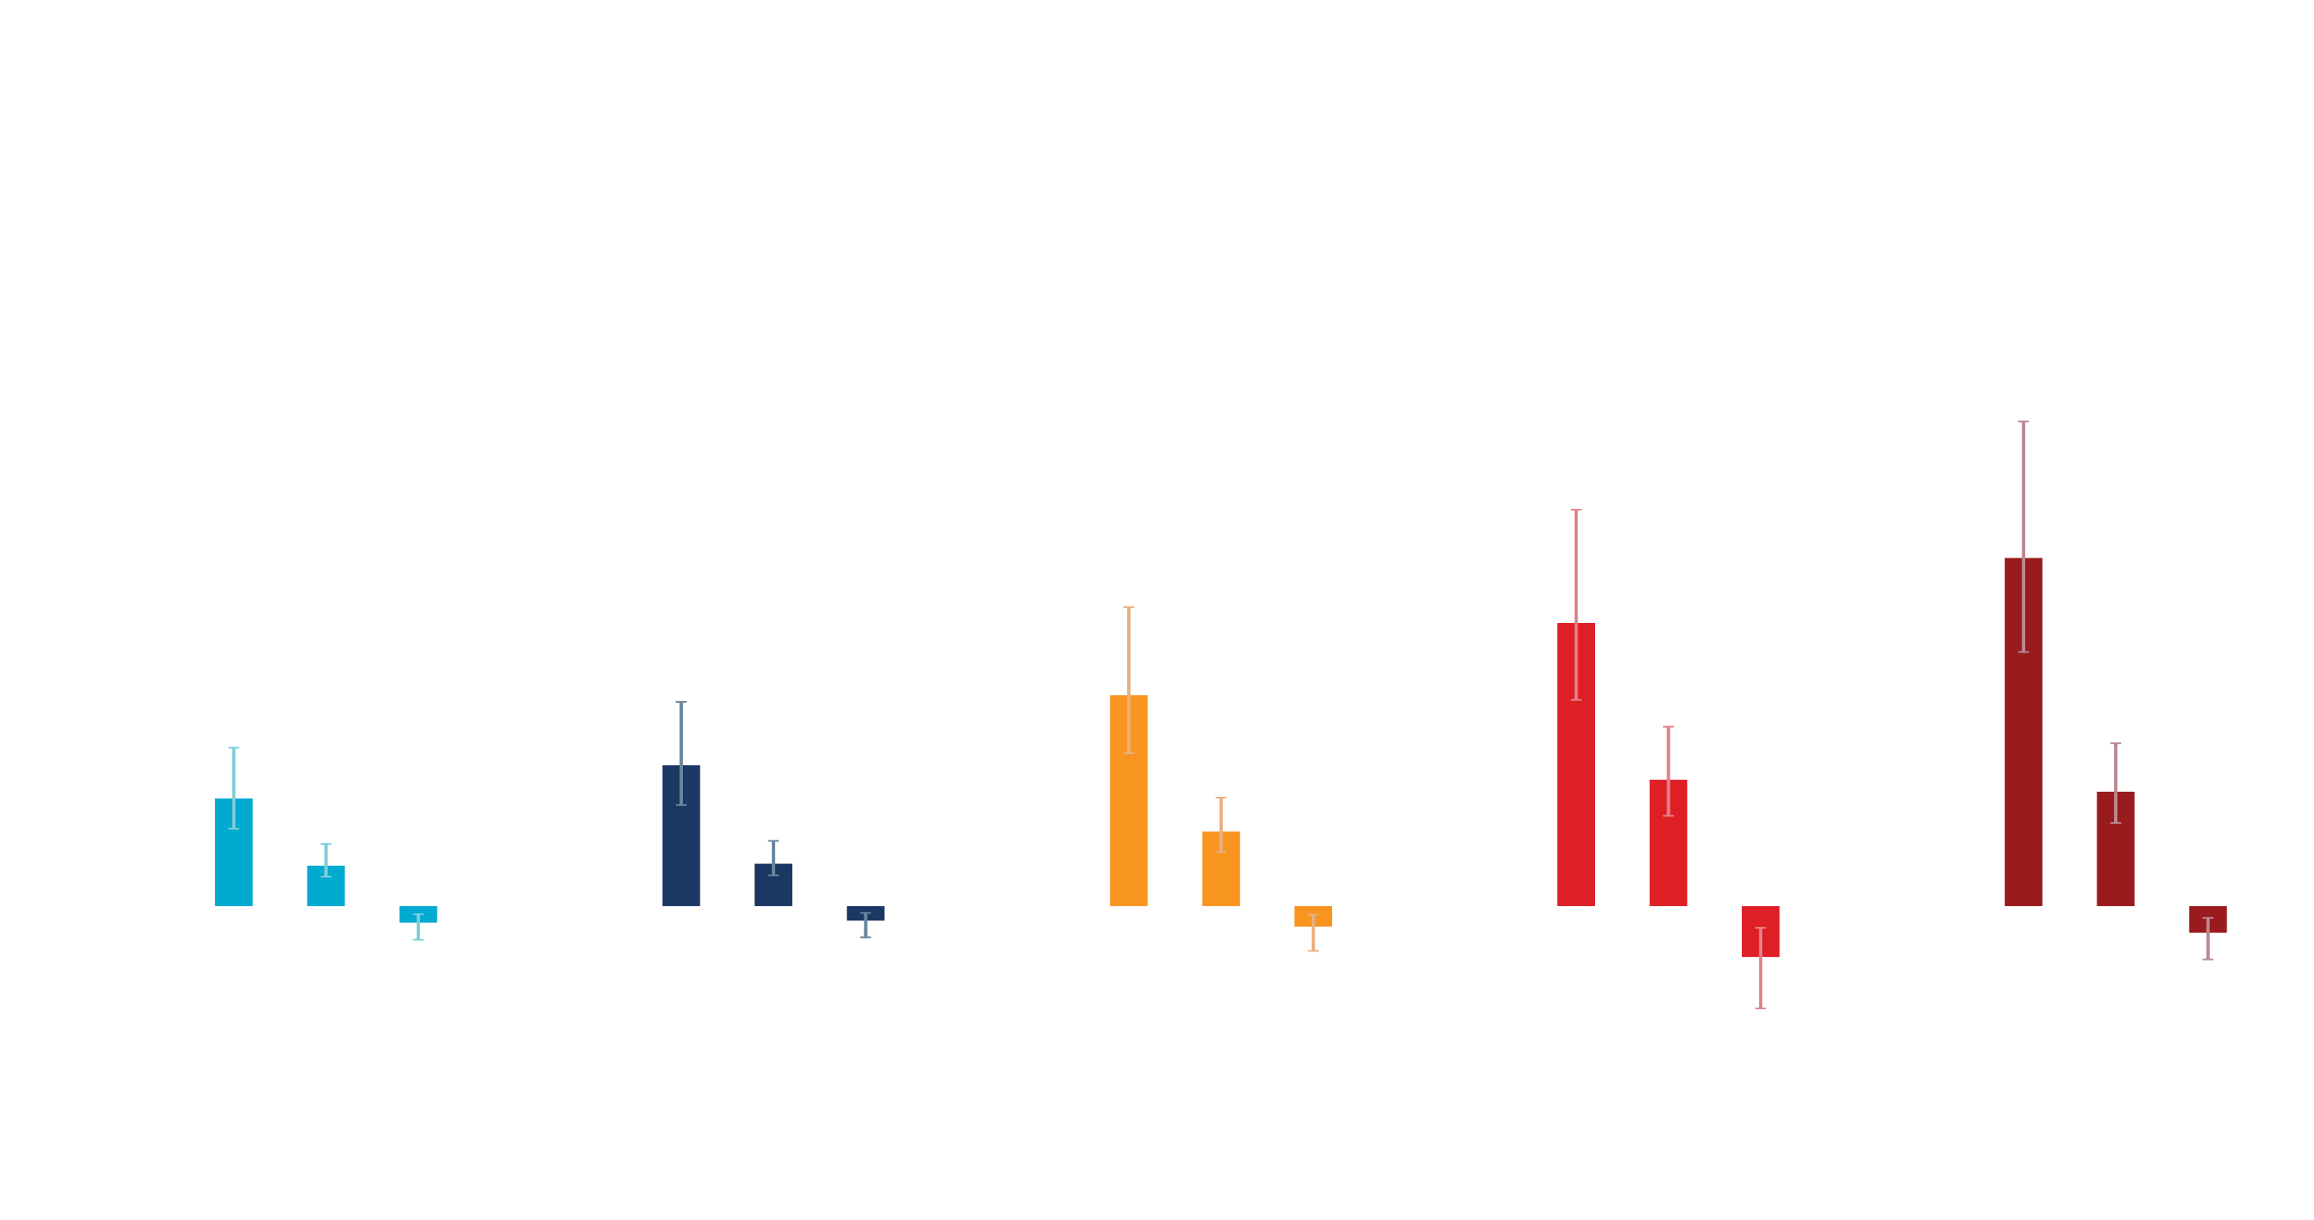
Figure SPM.4
Panel b
Contribution to global surface temperature increase from different emissions, with a dominant role of CO2 emissions
Message 3: Global warming is mainly caused by emissions of carbon dioxide
Change in 2081-2100 relative to 1850-1900 (°C)
Total warming (observed warming to date in darker shade), warming from CO2 and non-CO2 GHGs, and cooling from changes in aerosols and land use
Notes:
Message 3: Global warming is predominantly caused by emissions of carbon dioxide.
This report has assessed the contribution of all greenhouse gases to global warming as well as the contribution of aerosols and changes in land use.
Carbon dioxide emissions contribute the most to global warming.
Global warming is a combination of the warming effect by greenhouse gases that is counterbalanced by the cooling effect of small air pollution particles (aerosols) and of changes in land use.

