Slide 1
Figure SPM.7
The more we emit,
the less nature can help

Slide 2
Figure SPM.7
The proportion of CO₂ emissions taken up by land and ocean carbon sinks is smaller in scenarios with higher cumulative CO₂ emissions

Slide 3
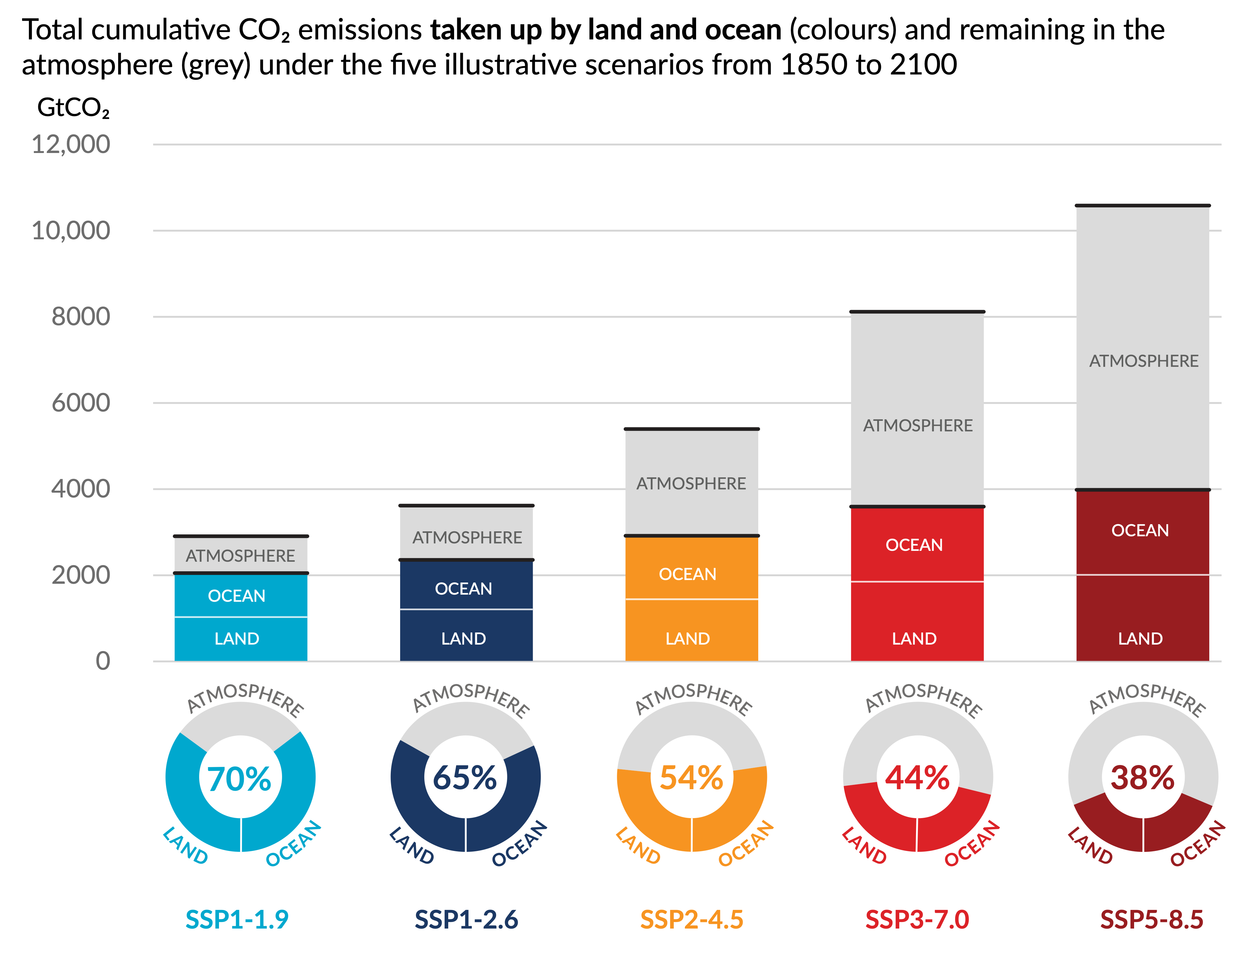
Figure SPM.7
The proportion of CO2 emissions taken up by land and ocean carbon sinks is smaller in scenarios with higher cumulative CO2 emissions
Notes:
The intent of this figure is to show that the proportion of CO2 emissions taken up by land and ocean carbon sinks is smaller in scenarios with higher cumulative CO2 emissions
This figure includes two important messages:
With increasing human-caused CO2 emissions, the amount taken up by natural (land and ocean) carbon sinks is larger, but more of the emitted CO2 remains in the atmosphere.
However, the proportion of emissions taken up by land and ocean carbon sinks is smaller with higher cumulative CO2 emissions, show by the pie charts.
-----------------------------------Caption-----------------------
Figure SPM.7 | Cumulative anthropogenic CO2 emissions taken up by land and ocean sinks by 2100 under the five illustrative scenarios
The cumulative anthropogenic (human-caused) carbon dioxide (CO2) emissions taken up by the land and ocean sinks under the five illustrative scenarios (SSP1-1.9, SSP1-2.6, SSP2-4.5, SSP3-7.0 and SSP5-8.5) are simulated from 1850 to 2100 by Coupled Model Intercomparison Project Phase 6 (CMIP6) climate models in the concentration-driven simulations. Land and ocean carbon sinks respond to past, current and future emissions; therefore, cumulative sinks from 1850 to 2100 are presented here. During the historical period (1850–2019) the observed land and ocean sink took up 1430 GtCO2 (59% of the emissions). The bar chart illustrates the projected amount of cumulative anthropogenic CO2 emissions (GtCO2) between 1850 and 2100 remaining in the atmosphere (grey part) and taken up by the land and ocean (coloured part) in the year 2100. The doughnut chart illustrates the proportion of the cumulative anthropogenic CO2 emissions taken up by the land and ocean sinks and remaining in the atmosphere in the year 2100. Values in % indicate the proportion of the cumulative anthropogenic CO2 emissions taken up by the combined land and ocean sinks in the year 2100. The overall anthropogenic carbon emissions are calculated by adding the net global land-use emissions from the CMIP6 scenario database to the other sectoral emissions calculated from climate model runs with prescribed CO2 concentrations. Land and ocean CO2 uptake since 1850 is calculated from the net biome productivity on land, corrected for CO2 losses due to land-use change by adding the land-use change emissions, and net ocean CO2 flux. {5.2.1; Table 5.1; 5.4.5; Figure 5.25; Box TS.5; Box TS.5, Figure 1}

Slide 4
Figure SPM.7
With higher CO2 emissions, the amount of CO2 emissions taken up by nature is larger, but more of the emitted CO2 remains in the atmosphere
Cumulative human-caused CO2 emissions (1850-2100)
Illustrative
greenhouse gas emissions scenarios
Very low
Low
Intermediate
High
Very high
Notes:
What the graph shows:
Y axis: Cumulative human-caused CO2 emissions taken up by land and ocean sinks by 2100, shown in colour.
X axis: Each bar graph shows one of the five illustrative greenhouse gas emissions scenarios assessed in the Working Group I report.
Time reference: 1850-2100
Key messages:
With increasing concentrations of CO2 in the atmosphere from human-caused emissions, the amount taken up by natural (land and ocean) carbon sinks is larger, however, more of the emitted CO2 remains in the atmosphere.
For the very low and low greenhouse gas emissions scenarios, where CO2 concentrations peak and decline during the 21st century, land and oceans begin to take up less carbon in response to declining atmospheric CO2 concentrations.
For the very low greenhouse gas emissions scenario, the combined land and ocean sinks could turn to become a weak source by 2100.

Slide 5
Figure SPM.7
The proportion of CO2 emissions taken up by nature from the atmosphere is smaller in scenarios with higher CO2 emissions (1850-2100)
Very low
Low
Intermediate
High
Very high
Illustrative greenhouse gas emissions scenarios
Notes:
What the graph shows:
Value (%): proportion of the cumulative human-caused CO2 emissions over the period 1850-2100 taken up by the natural land and ocean sinks compared to that remaining in the atmosphere.
Key messages:
The natural sinks become less effective and the proportion of emissions taken up by land and ocean decreases with increasing human-caused cumulative CO2 emissions.
This results in a higher proportion of emitted CO2 remaining in the atmosphere compared to the land and ocean.
In other words, nature’s capacity to remove CO2 becomes weaker, the more CO2 we emit.

