Slide 1

Figure SPM.5
More warming,
more changes

Slide 2
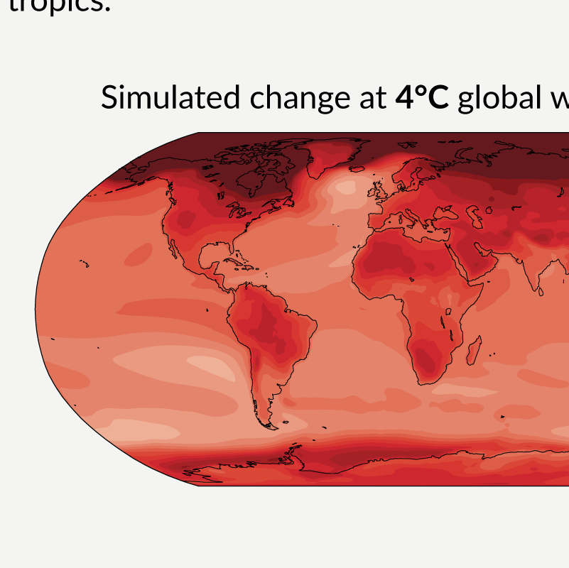
Figure SPM.5
With every increment of global warming, changes get larger in regional mean temperature, precipitation and soil moisture

Slide 3
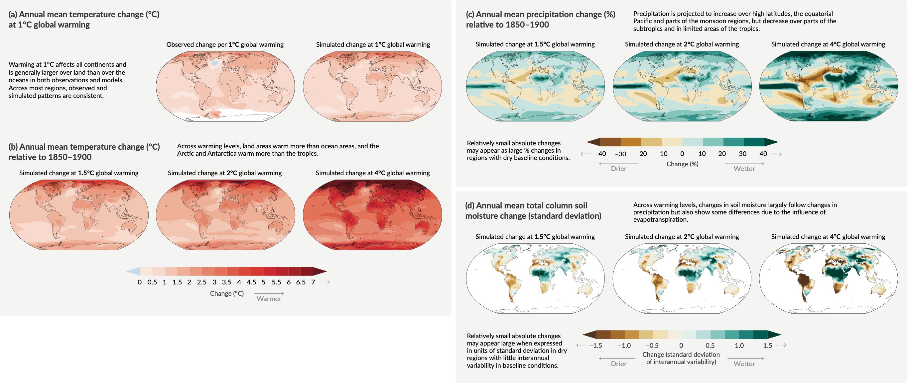
Figure SPM.5
With every increment of global warming, changes get larger in regional mean temperature, precipitation and soil moisture
Notes:
The intent of this figure is to show that with every increment of global warming, changes get larger in regional mean temperature, precipitation and soil moisture.
This figure includes two important messages:
Many changes in the climate system happen in direct relation to increasing global warming.
Increasing global warming leads to increasing regional changes in hot extremes, precipitation and soil moisture.
-----------------------------------Caption-----------------------
Figure SPM.5 | Changes in annual mean surface temperature, precipitation, and soil moisture
Panel (a) Comparison of observed and simulated annual mean surface temperature change. The left map shows the observed changes in annual mean surface temperature in the period 1850–2020 per °C of global warming (°C). The local (i.e., grid point) observed annual mean surface temperature changes are linearly regressed against the global surface temperature in the period 1850–2020. Observed temperature data are from Berkeley Earth, the dataset with the largest coverage and highest horizontal resolution. Linear regression is applied to all years for which data at the corresponding grid point is available. The regression method was used to take into account the complete observational time series and thereby reduce the role of internal variability at the grid point level. White indicates areas where time coverage was 100 years or less and thereby too short to calculate a reliable linear regression. The right map is based on model simulations and shows change in annual multi-model mean simulated temperatures at a global warming level of 1°C (20-year mean global surface temperature change relative to 1850–1900). The triangles at each end of the colour bar indicate out-of-bound values, that is, values above or below the given limits.
Panel (b) Simulated annual mean temperature change (°C), panel (c) precipitation change (%), and panel (d) total column soil moisture change (standard deviation of interannual variability) at global warming levels of 1.5°C, 2°C and 4°C (20-year mean global surface temperature change relative to 1850–1900). Simulated changes correspond to Coupled Model Intercomparison Project Phase 6 (CMIP6) multi-model mean change (median change for soil moisture) at the corresponding global warming level, that is, the same method as for the right map in panel (a).
In panel (c), high positive percentage changes in dry regions may correspond to small absolute changes. In panel (d), the unit is the standard deviation of interannual variability in soil moisture during 1850–1900. Standard deviation is a widely used metric in characterizing drought severity. A projected reduction in mean soil moisture by one standard deviation corresponds to soil moisture conditions typical of droughts that occurred about once every six years during 1850–1900. In panel (d), large changes in dry regions with little interannual variability in the baseline conditions can correspond to small absolute change. The triangles at each end of the colour bars indicate out-of-bound values, that is, values above or below the given limits. Results from all models reaching the corresponding warming level in any of the five illustrative scenarios (SSP1-1.9, SSP1-2.6, SSP2-4.5, SSP3-7.0 and SSP5-8.5) are averaged. Maps of annual mean temperature and precipitation changes at a global warming level of 3°C are available in Figure 4.31 and Figure 4.32 in Section 4.6. Corresponding maps of panels (b), (c) and (d), including hatching to indicate the level of model agreement at grid-cell level, are found in Figures 4.31, 4.32 and 11.19, respectively; as highlighted in Cross-Chapter Box Atlas.1, grid-cell level hatching is not informative for larger spatial scales (e.g., over AR6 reference regions) where the aggregated signals are less affected by small-scale variability, leading to an increase in robustness.
{Figure 1.14, 4.6.1, Cross-Chapter Box 11.1, Cross-Chapter Box Atlas.1, TS.1.3.2, Figures TS.3 and TS.5}

Slide 4
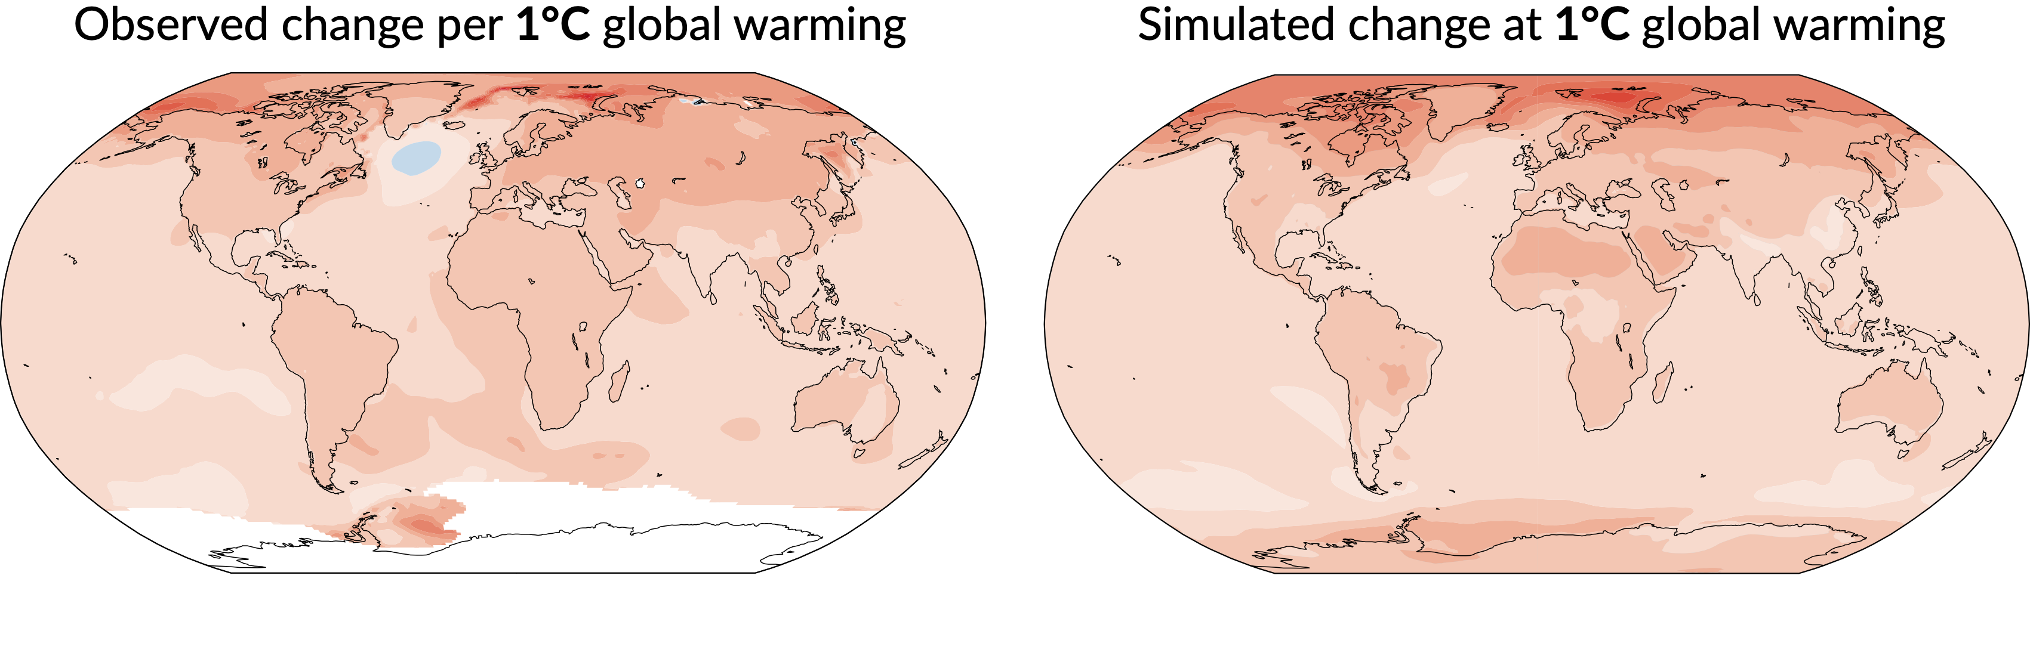
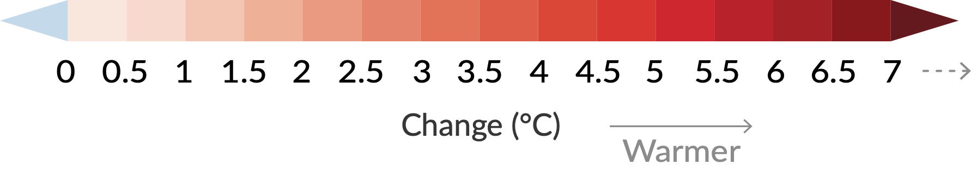
Figure SPM.5
Panel a
Annual mean temperature change (°C) at 1°C global warming
Notes:
The maps in Figure SPM.5 panel (a) show a comparison of observed and model simulated annual mean surface temperature change.
Left: observed changes in annual mean surface temperature in the period 1850–2020 of 1°C global warming
Right: changes simulated with climate models at 1°C global warming compared to the period 1850-1900
Key messages:
With every additional increment of global warming, the pattern of observed temperature trends intensifies in every region.
Warming is larger over land and in the Arctic than the global average.
Climate model simulations are able to reproduce the observed patterns of temperature changes across most regions.

Slide 5
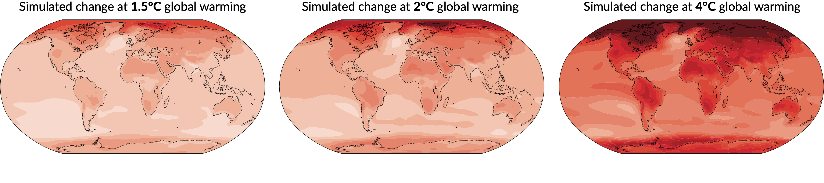
Figure SPM.5
Panel b
Annual mean temperature change (°C) relative to 1850-1900
Notes:
Key messages:
With increasing global warming (1.5°C, 2°C and 4°C), land warms more than oceans, and the polar regions warm more than the tropics.
Changes will continue to be amplified over land and the polar regions compared to the global average.
The Arctic will continue to warm at over two times the rate of the global surface temperature.
At 2°C of global warming, most of the Arctic reaches changes in temperature of 4°C or more compared to the temperatures in the late 19th century.

Slide 6
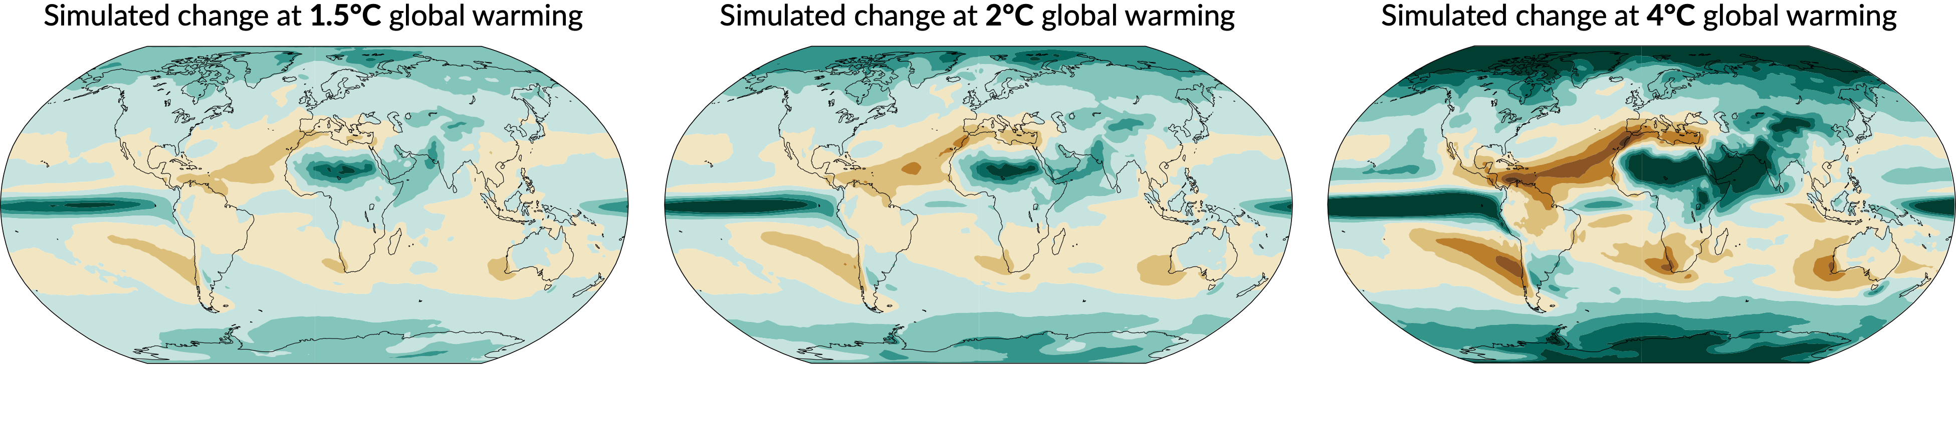
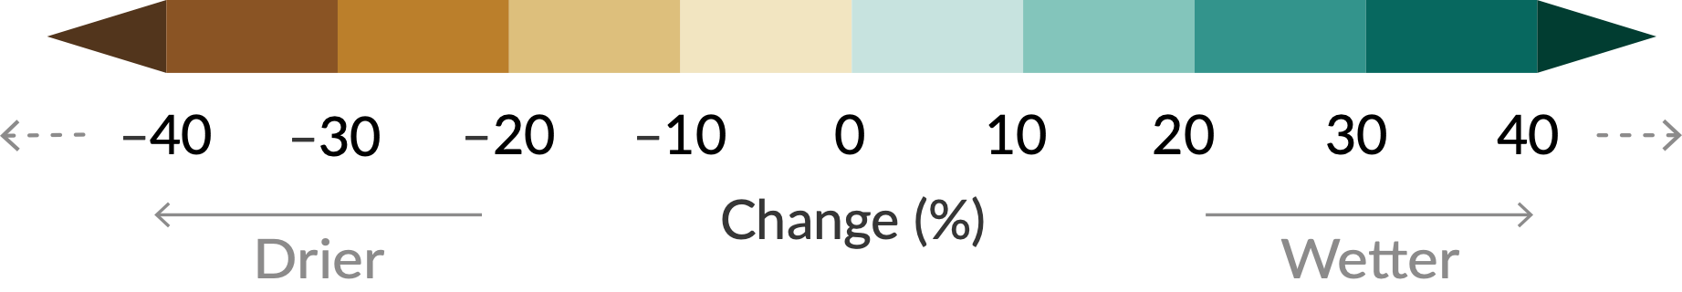
Figure SPM.5
Panel c
Annual mean precipitation change (%) relative to 1850-1900
Notes:
Key messages:
With increasing global warming, precipitation is projected to increase over high latitudes, the equatorial Pacific, and parts of the monsoon regions but to decrease over parts of the subtropics.
Increasing global warming is projected to further intensify the global water cycle, including its year-to-year variability, global monsoon precipitation and the severity of wet and dry events.

Slide 7
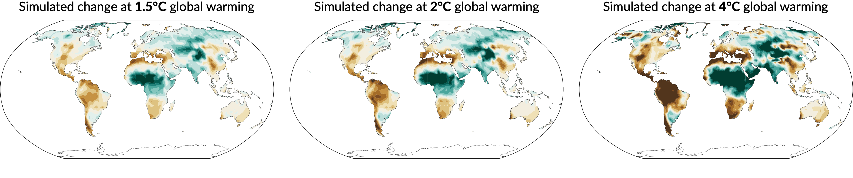
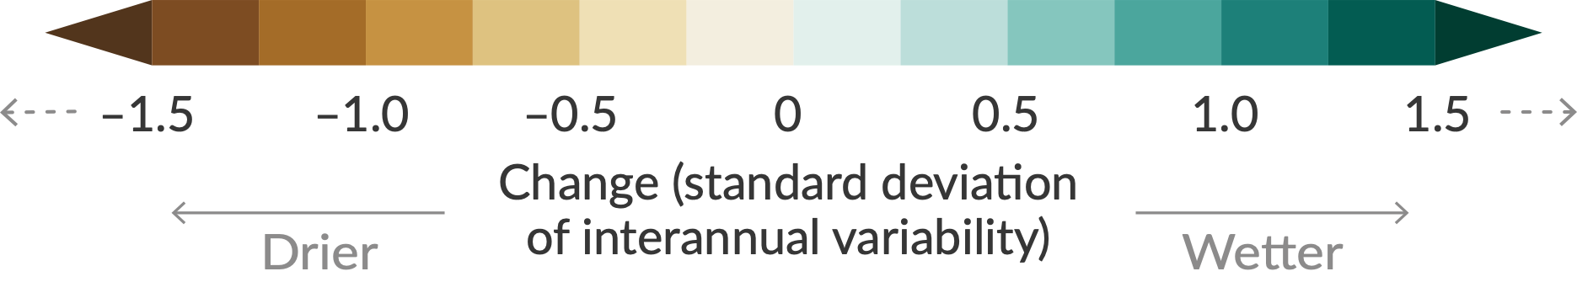
Figure SPM.5
Panel d
Annual mean total column soil moisture change (standard deviation)
Notes:
Key messages:
Soil moisture is important for agriculture and ecosystems.
Changes in soil moisture with increasing global warming follow changes in precipitation, but there are differences in some regions due to changes in evaporation from soils and in transpiration from plants.
With increasing global warming, the water in soil will evaporate faster.

