Slide 1
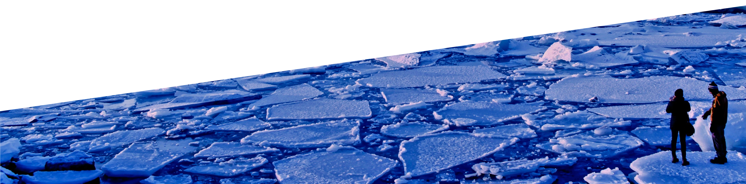
Figure SPM.8
Some changes in the climate can be slowed and even stopped

Slide 2
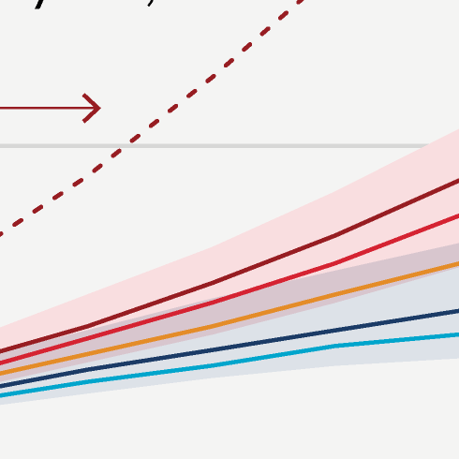
Figure SPM.8
Human activities affect all the major climate system components, with some responding over decades and others over centuries

Slide 3
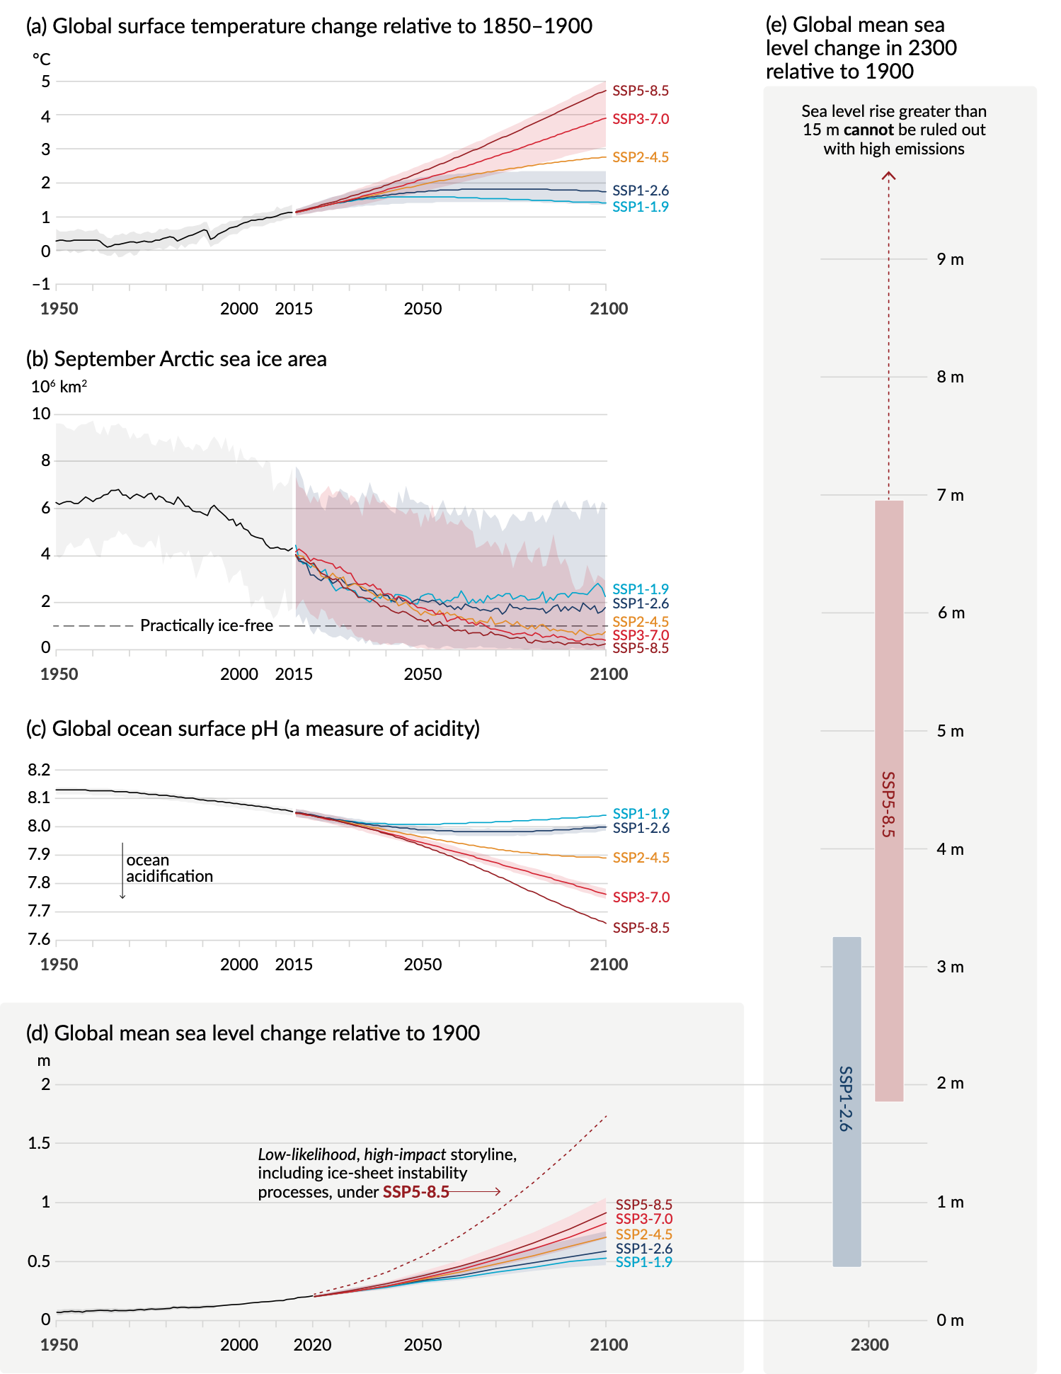
Figure SPM.8
Human activities affect all the major climate system components, with some responding over decades and others over centuries
Notes:
The intent of this figure is to show that human activities affect all the major climate system components, with some responding over decades and others over centuries.
This figure includes three important messages:
With rapid and strong reductions of greenhouse gas emissions, some changes in the climate system can be stopped by mid-century.
Some changes are irreversible over centuries to millennia, but they can be slowed by limiting warming.
Low-likelihood, high impact storylines leading to very high sea levels cannot be ruled out.
-----------------------------------Caption-----------------------
Figure SPM.8 | Selected indicators of global climate change under the five illustrative scenarios used in this Report
The projections for each of the five scenarios are shown in colour. Shades represent uncertainty ranges – more detail is provided for each panel below. The black curves represent the historical simulations (panels a, b, c) or the observations (panel d). Historical values are included in all graphs to provide context for the projected future changes. Panel (a) Global surface temperature changes in °C relative to 1850–1900. These changes were obtained by combining Coupled Model Intercomparison Project Phase 6 (CMIP6) model simulations with observational constraints based on past simulated warming, as well as an updated assessment of equilibrium climate sensitivity (see Box SPM.1). Changes relative to 1850–1900 based on 20-year averaging periods are calculated by adding 0.85°C (the observed global surface temperature increase from 1850–1900 to 1995–2014) to simulated changes relative to 1995–2014. Very likely ranges are shown for SSP1-2.6 and SSP3-7.0.
Panel (b) September Arctic sea ice area in 106 km2 based on CMIP6 model simulations. Very likely ranges are shown for SSP1-2.6 and SSP3-7.0. The Arctic is projected to be practically ice-free near mid-century under intermediate and high GHG emissions scenarios.
Panel (c) Global ocean surface pH (a measure of acidity) based on CMIP6 model simulations. Very likely ranges are shown for SSP1-2.6 and SSP3-7.0.
Panel (d) Global mean sea level change in metres, relative to 1900. The historical changes are observed (from tide gauges before 1992 and altimeters afterwards), and the future changes are assessed consistently with observational constraints based on emulation of CMIP, ice-sheet, and glacier models. Likely ranges are shown for SSP1-2.6 and SSP3-7.0. Only likely ranges are assessed for sea level changes due to difficulties in estimating the distribution of deeply uncertain processes. The dashed curve indicates the potential impact of these deeply uncertain processes. It shows the 83rd percentile of SSP5-8.5 projections that include low-likelihood, high-impact ice-sheet processes that cannot be ruled out; because of low confidence in projections of these processes, this curve does not constitute part of a likely range. Changes relative to 1900 are calculated by adding 0.158 m (observed global mean sea level rise from 1900 to 1995–2014) to simulated and observed changes relative to 1995–2014.
Panel (e) Global mean sea level change at 2300 in metres relative to 1900. Only SSP1-2.6 and SSP5-8.5 are projected at 2300, as simulations that extend beyond 2100 for the other scenarios are too few for robust results. The 17th–83rd percentile ranges are shaded. The dashed arrow illustrates the 83rd percentile of SSP5-8.5 projections that include low-likelihood, high-impact ice-sheet processes that cannot be ruled out.
Panels (b) and (c) are based on single simulations from each model, and so include a component of internal variability. Panels (a), (d) and (e) are based on long-term averages, and hence the contributions from internal variability are small.
{4.3; Figures 4.2, 4.8, and 4.11; 9.6; Figure 9.27; Figures TS.8 and TS.11; Box TS.4, Figure 1}

Slide 4
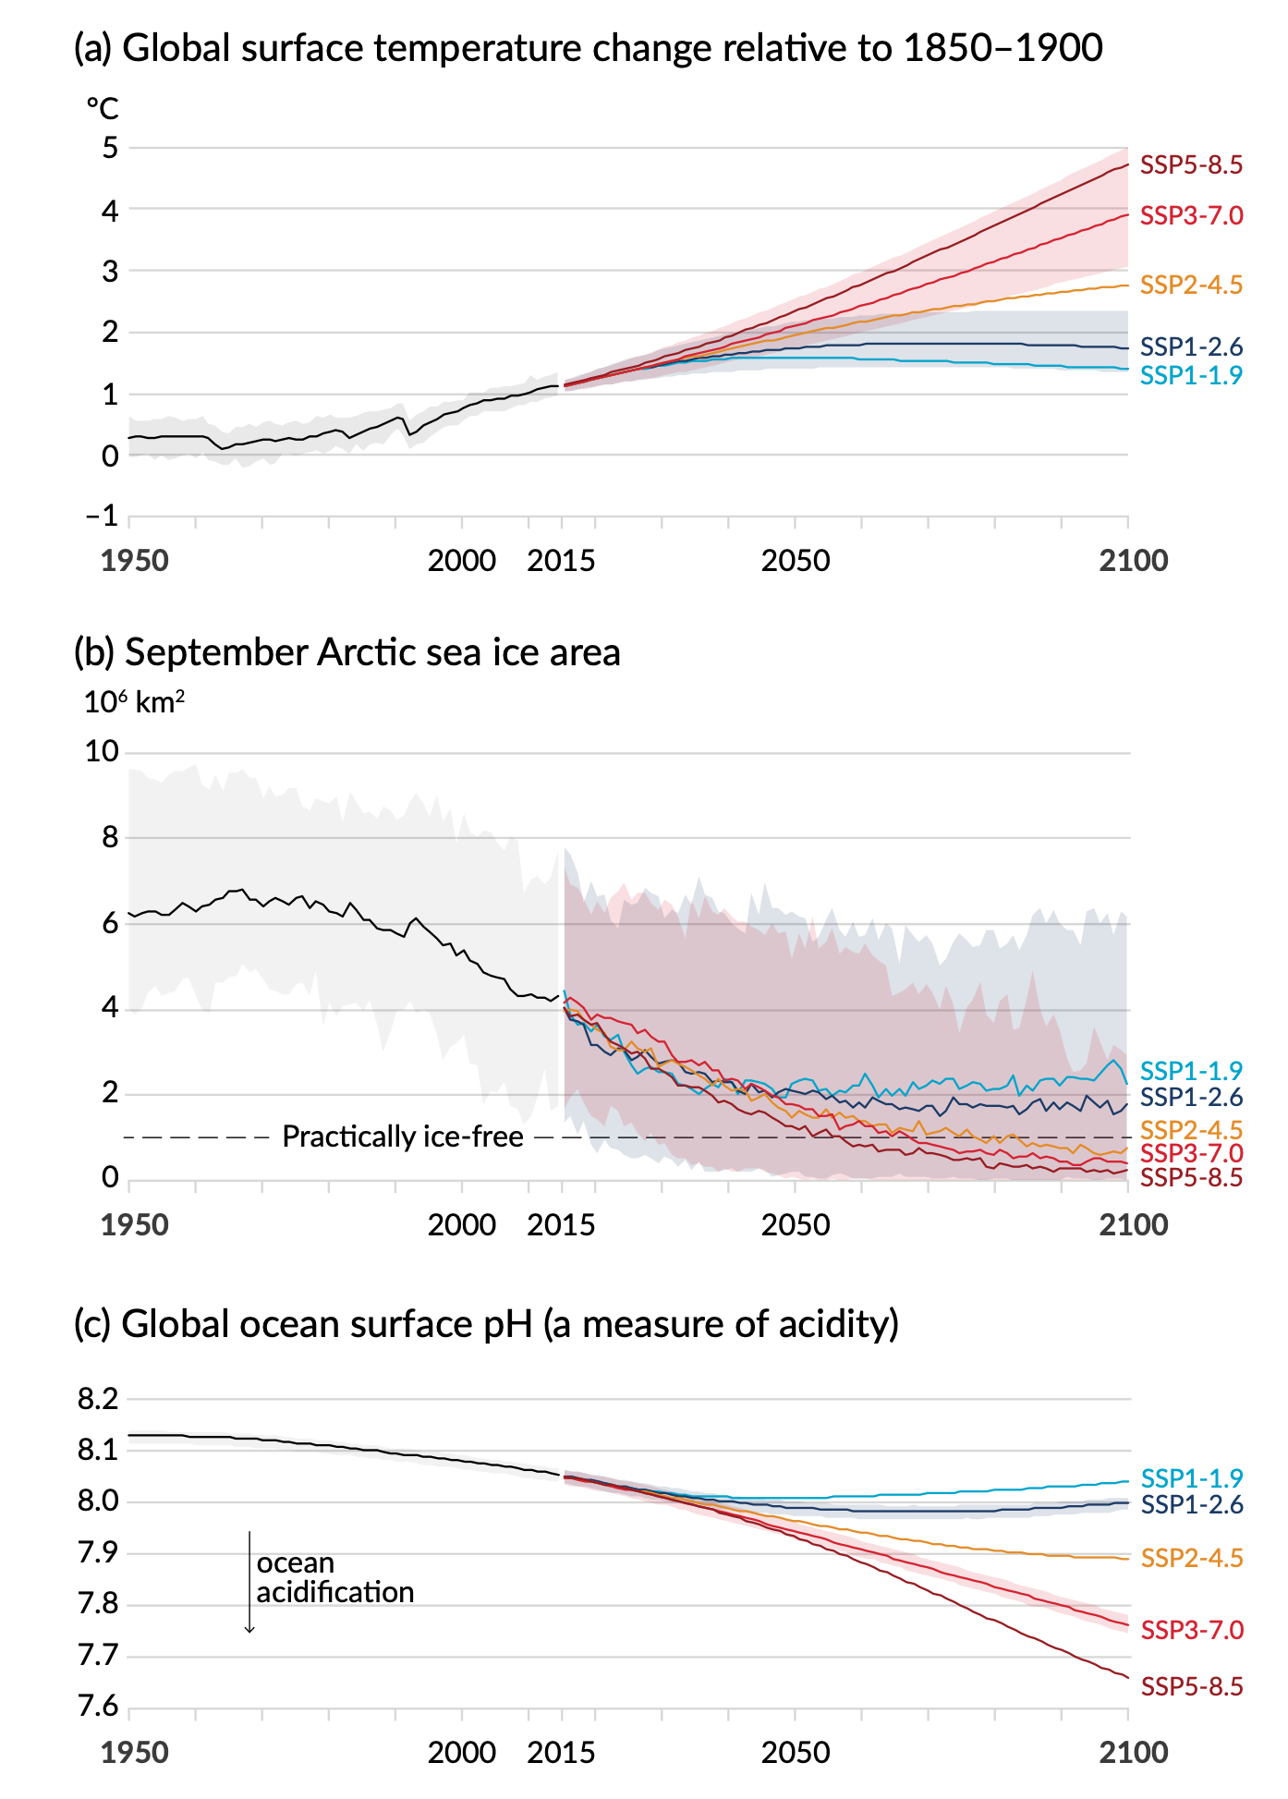
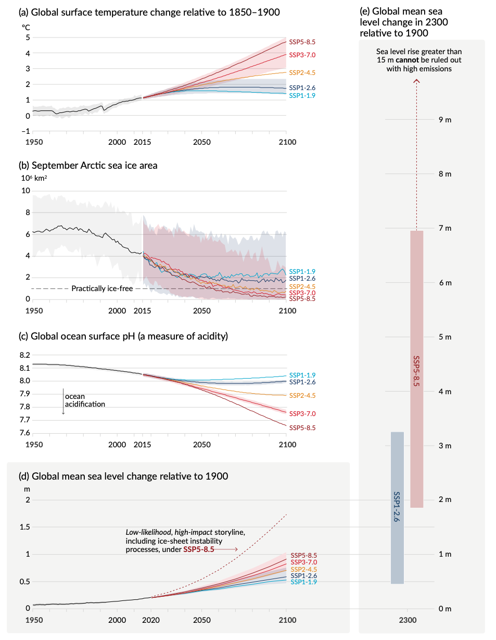
Figure SPM.8
Panel a, b, c
Message 1: With rapid and strong reductions of GHG emissions, some changes can be stopped by the mid-century
Notes:
Message 1: With rapid and strong reductions of greenhouse gas emissions, some changes in the climate system can be reduced or stopped by the mid-century.
What the graph shows:
Y axis: panel a - global surface temperature change (°C), panel b - Arctic sea ice area (million km²), panel c - ocean surface acidity (pH, where the lower the pH, the higher the acidity).
X axis: time from 1950 to 2100.
Changes are shown relative to the period 1850-1900.
The shading shows the very likely ranges.
Key messages:
Many changes in the climate system become larger in direct relation to increasing global warming
With rapid and strong reductions of greenhouse gas emissions, as shown with very low and low greenhouse gas emissions scenarios (light blue and dark blue, respectively), we can halt these changes relatively quickly.

Slide 5
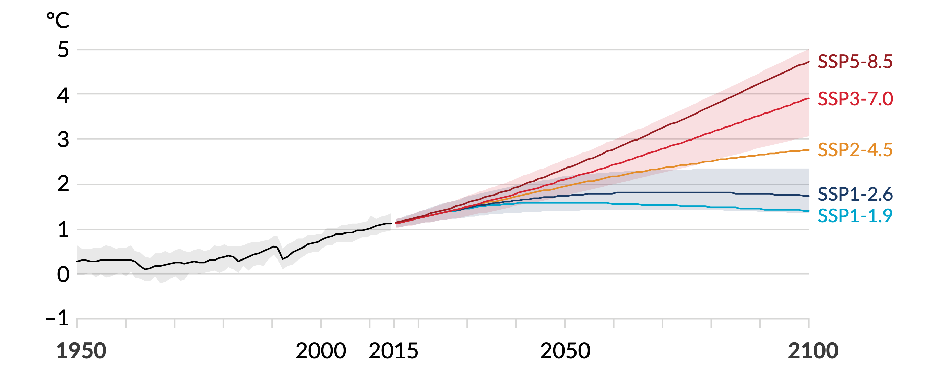
Figure SPM.8
Panel a
Global surface temperature change relative to 1850-1900
Message 1: With rapid and strong reductions of GHG emissions, some changes can be stopped by the mid-century
Notes:
Global surface temperature is projected to increase depending on the future level of human-caused greenhouse gas emissions, as shown with the five assessed scenarios.

Slide 6
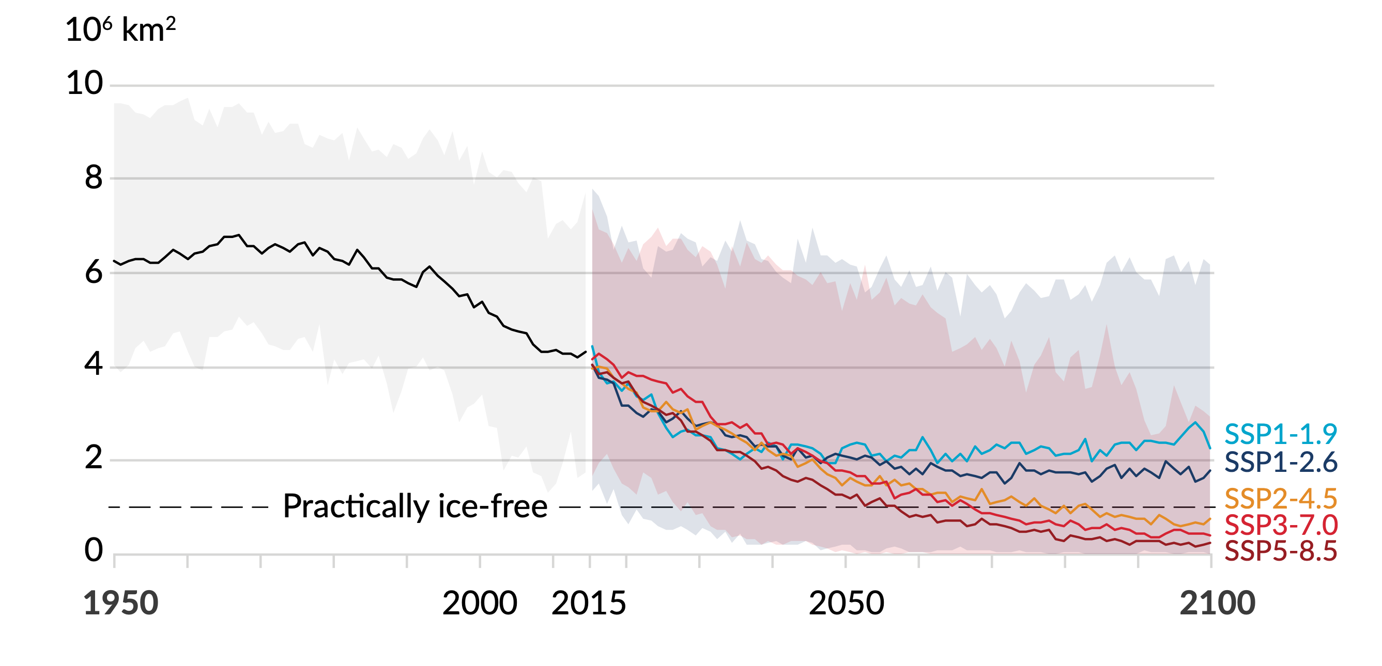
Figure SPM.8
Panel b
September Arctic sea ice area
Message 1: With rapid and strong reductions of GHG emissions, some changes can be stopped by the mid-century
Notes:
There is a direct relation between changes in Arctic sea ice area and global warming.
With increasing global warming, the Arctic is likely to be practically sea ice free in September at least once before 2050 under the five assessed scenarios, with more frequent occurrences for higher warming levels.

Slide 7
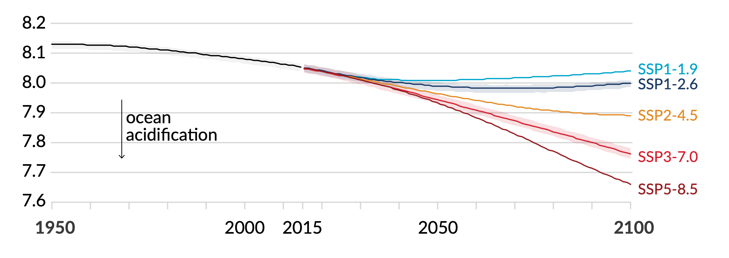
Figure SPM.8
Panel c
Global ocean surface pH (measure of acidity)
Message 1: With rapid and strong reductions of GHG emissions, some changes can be stopped by the mid-century
Notes:
Upper ocean acidification and loss of oxygen will continue to increase in the 21st century with increasing future emissions.

Slide 8
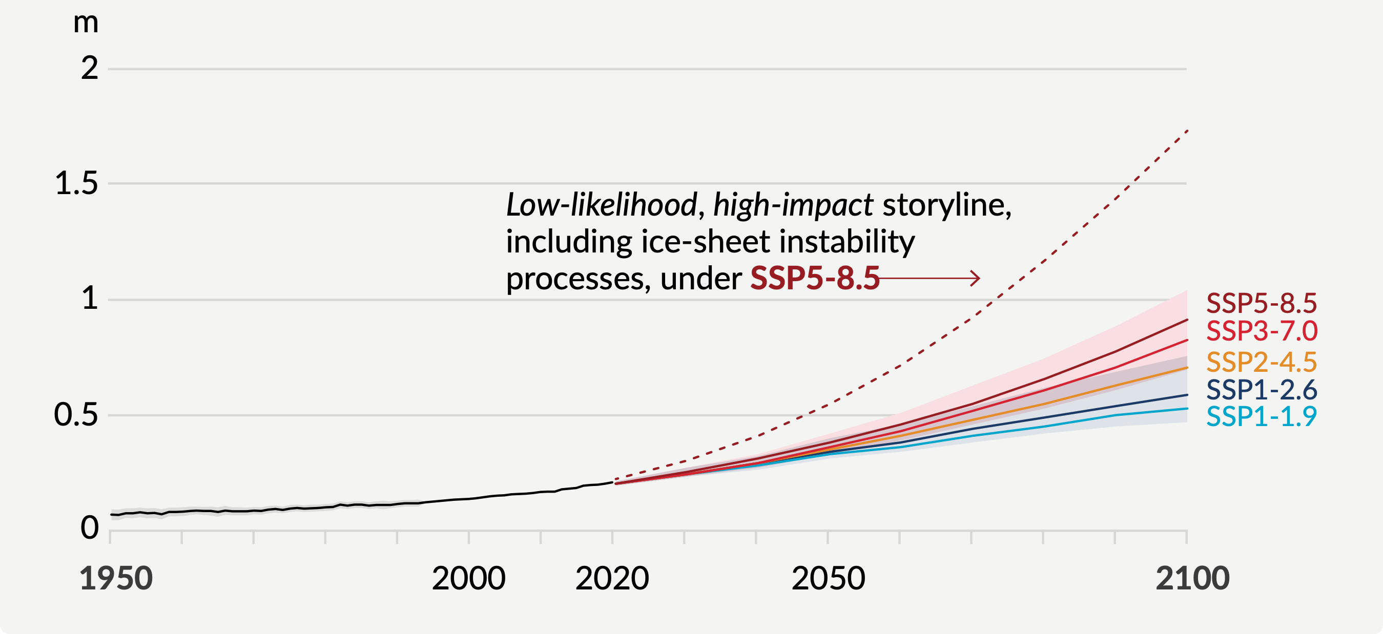
Figure SPM.8
Panel d
Global mean sea level change relative to 1900
Message 2: Some changes are irreversible for centuries to millennia
Notes:
Message 2: Some changes are irreversible for centuries to millennia.
What the graph shows:
Y axis: sea level change in meters.
The shading shows the very likely (66%) ranges.
Dashed line: Low-likelihood, high-impact storylines that includes ice-sheet instability processes cannot be ruled out because of deep uncertainty in ice-sheet processes. This is shown here for a very high greenhouse gas emissions scenario.
Key messages:
The slow component of the climate system will continue to adjust on timescales of hundreds to thousands of years.
Sea level is committed to rise for centuries to millennia due to continuing deep ocean warming and ice sheet melt, and will remain elevated for thousands of years.
Global mean sea level will continue to rise over thousands of years with a rate and magnitude depending on future global greenhouse gas emissions.
By 2050, sea level is committed to rise by 15-30 cm above present-day level, almost independently of how quickly we reduce global greenhouse gas emissions.
However, limiting warming would slow and limit the pace of sea level rise, giving more time to adapt in low lying coastal zones.
Beyond 2050, sea level will continue to rise, but with a rate and magnitude strongly dependent on choices regarding future greenhouse gas emissions.
For the very high greenhouse gas emission scenario, we cannot rule out the possibility that rapid ice-sheet loss could lead to 2 m sea level rise by the end of this century.

Slide 9
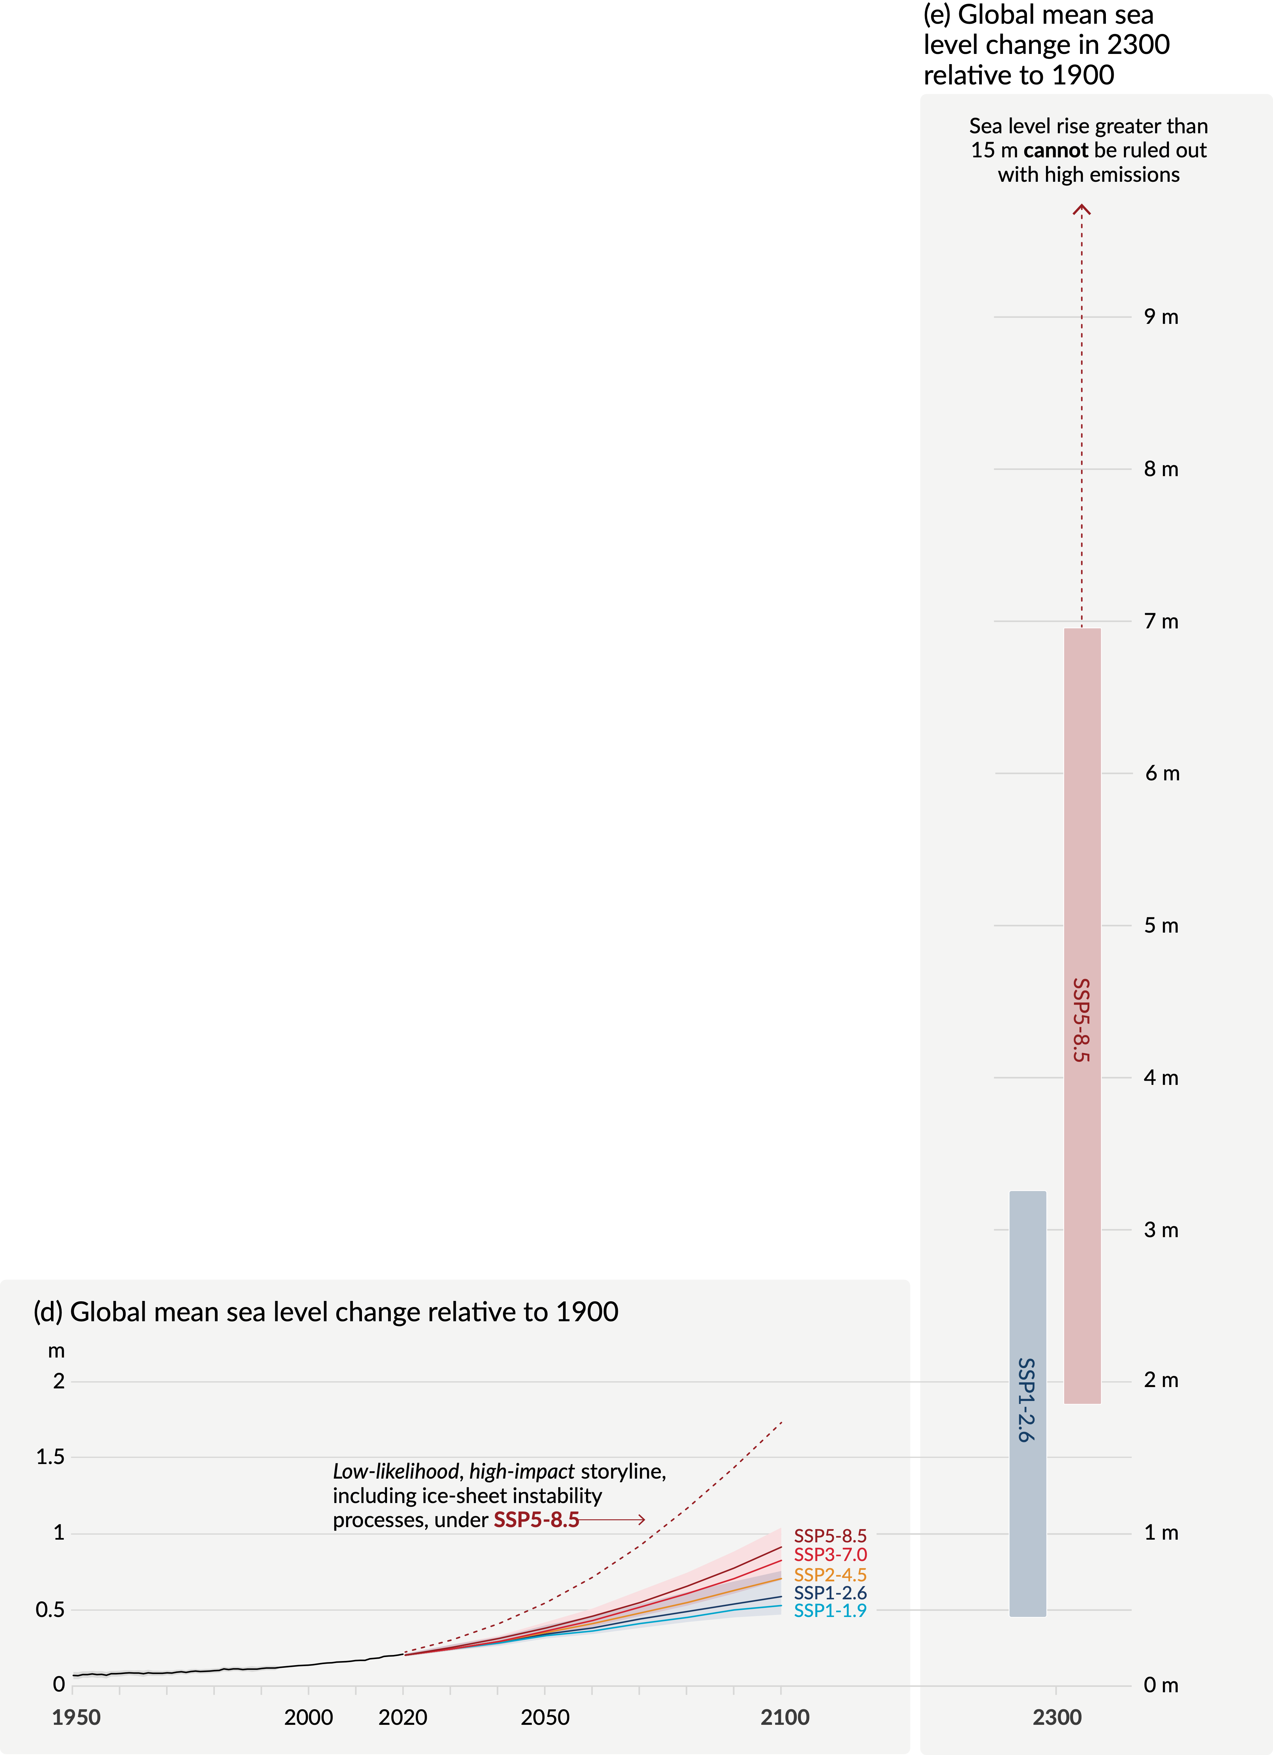
Figure SPM.8
Panel e
(e) Global mean sea level change in 2300 relative to 1900
Message 3: low-likelihood, high impact storylines leading to very high sea levels cannot be ruled out
(d) Global mean sea level change relative to 1900
Notes:
Message 3: low-likelihood, high impact storylines leading to very high sea levels cannot be ruled out
Under high future emissions, sea level rise will continue well beyond 2100.
By 2300
A low greenhouse gas emissions scenario would lead to a sea level rise of around 50 cm to 3 m
A very high greenhouse gas emissions scenario could lead to 2 to 7 m of rise, and potentially many meters more when accounting for ice sheet instability processes.
These estimates of very long term global mean sea level rise are consistent with reconstructed levels during past warm periods
Sea level rise greater than 15 m cannot be ruled out with very high emissions due to deep uncertainty on Antarctic ice sheet dynamics.

